Slide 1
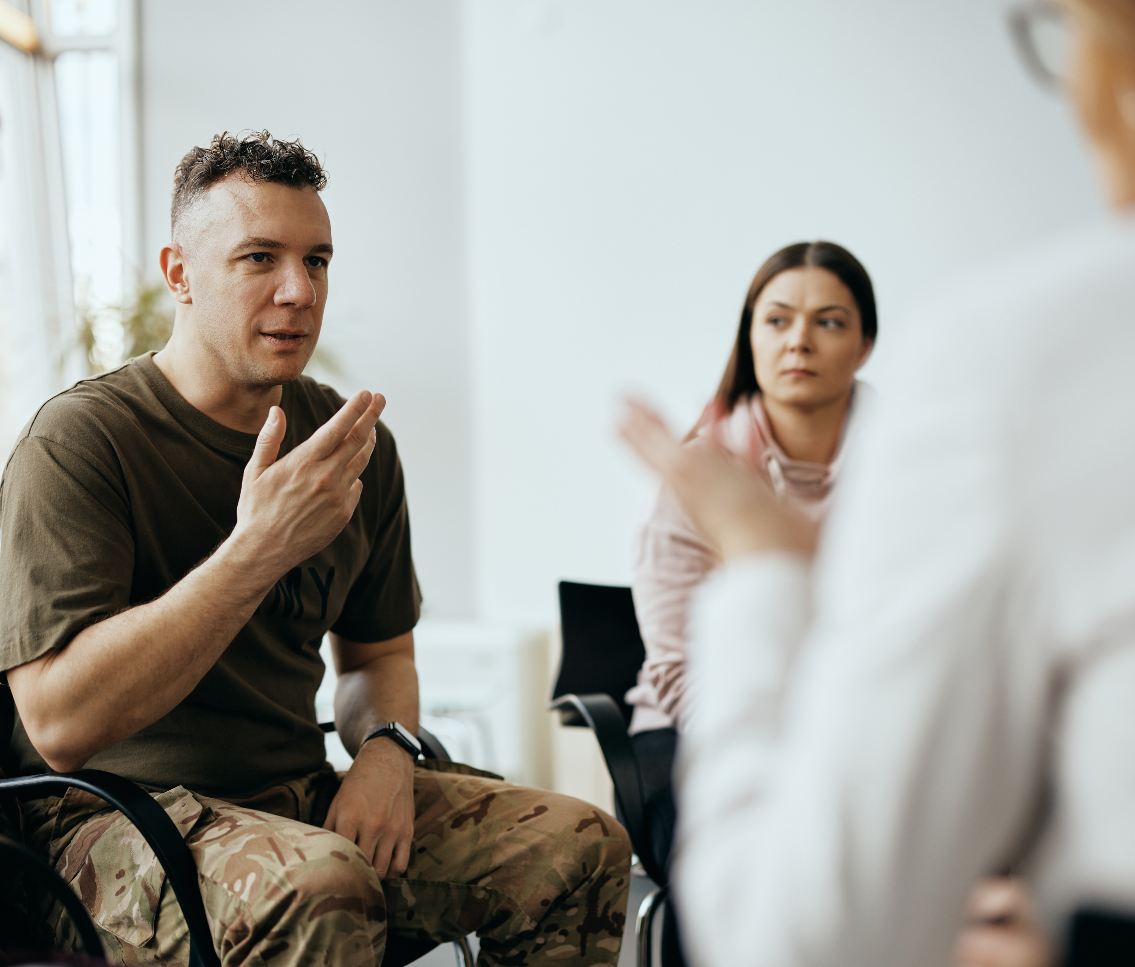
Innovative Solutions to Support Veterans

Slide 2
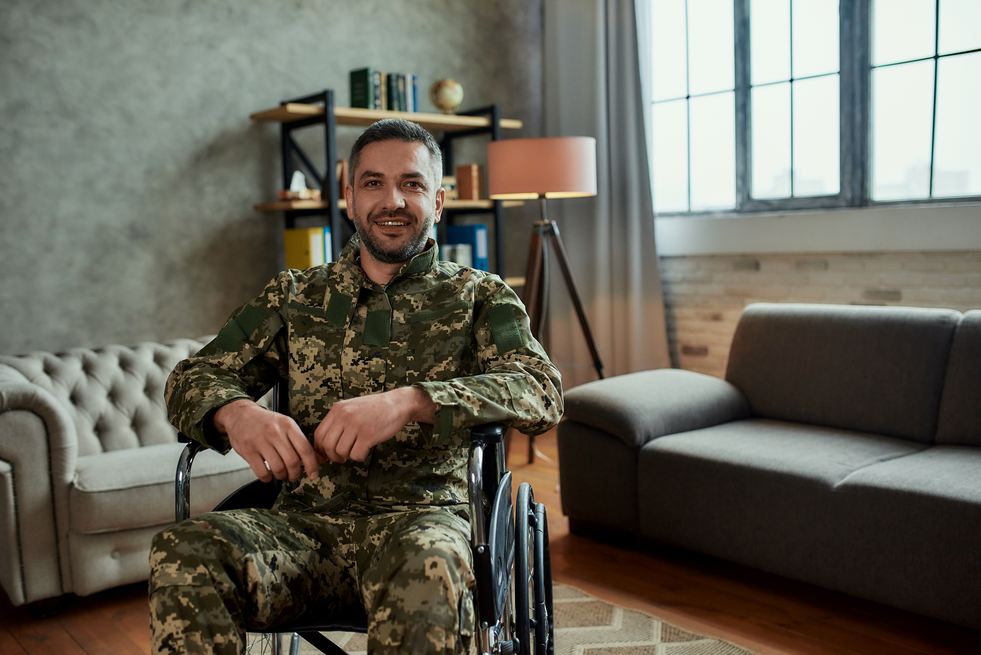
Common Challenges Veterans Face
Education and skills training
Seeking and securing stable employment
Access to support networks
Mental health
Healthcare
Physical therapy
Food and housing
Transportation
Communication and connectivity
FACT: Veterans are 50% more likely to become homeless than other Americans due to poverty, lack of support networks, and dismal living conditions in overcrowded or substandard housing.

Slide 3
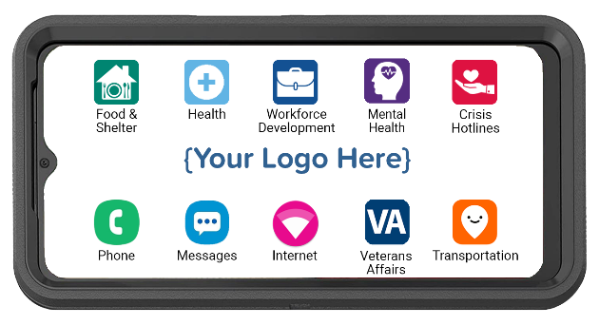
Is There a Better Way?
CPR³: Connecting Veterans to Resources

Slide 4
The Layer Cake Approach
Provide Workforce Development and Jobs
Address Mental Health and Health Care Issues
Meet Basic Needs

Slide 5
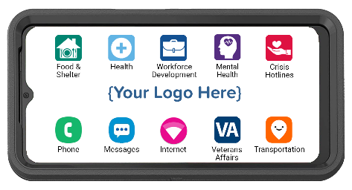
Meeting Basic Needs
The CPR³ solution is custom-built to provide access to many different resources.
People simply tap the icon and get connected to available resources.
Food & Housing
Health
Veterans Affairs
Crisis Hotline
Local food banks
Local shelters
Housing assistance
SNAP (food stamps)
WIC
Telehealth
Local VA
Schedule Appointments
Prescription Assistance
Disability
Pension
Life Insurance
Records
Service Member Benefits
Suicide Prevention
Sexual Abuse
LGBTQ Support
Domestic Violence
Substance Abuse
Icons can be an individual app, a link to a webpage or a folder containing multiple apps and webpage links.

Slide 6
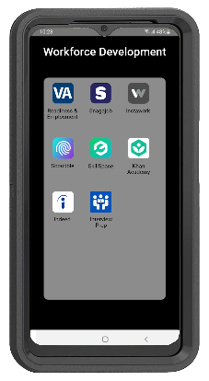
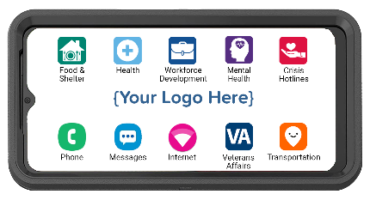
Workforce Development & Careers
Training and/or jobs icons provide access to a folder with basic education, skills training, and job resources.
FACT: 40% of American business leaders need help finding employees with in-demand skills, even for entry-level positions.

Slide 7
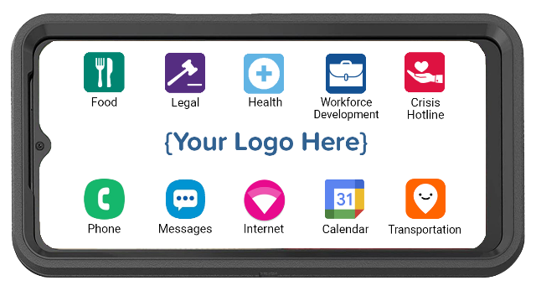
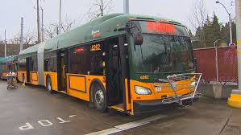
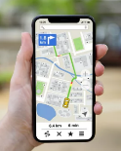
Access to Maps & Transportation
Map and transportation icons provide the ability to plan public transit usage and routes.
Google Maps and Access to Transportation Options
Simplify Mobility Needs

Slide 8
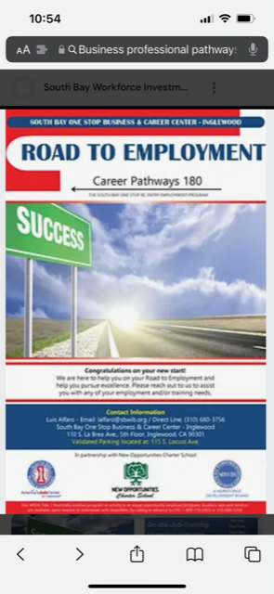
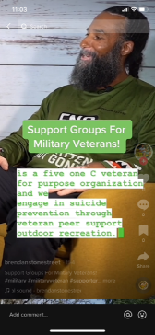
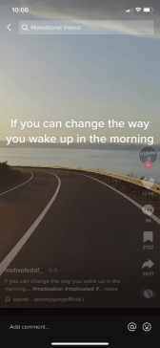
Teach, Reach & Motivate With Videos
Workforce Development
Virtual Support Groups
Music & Meditation

Slide 9
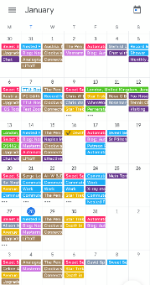
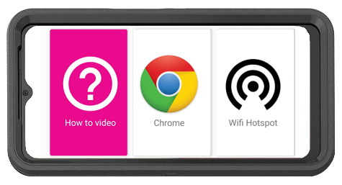
Level Up to Close the Gaps
Additional icons can include:
Google Workspace – connect, communicate, collaborate
Social Media - network with others on social media
Music and meditation
Additional veteran resources
Additional local resources

Slide 10
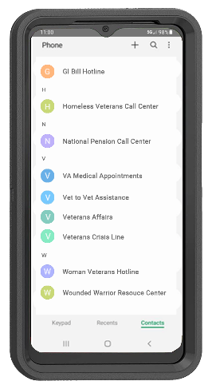
CPR³ Unlimited Communication
+
Provides the ability to call 911 in an emergency
Provides the ability to communicate with a stable and consistent phone.
Provides Veterans with a pre-programmed resource phone directory; easily update at any time.

Slide 11
CPR³ Unlimited Internet Access
Provides instant on-screen internet access
Provides a hotspot for up to 8 other devices
Includes a How-To Video with step-by-step instructions to connect other devices to the hotspot. Current languages include:
English
Spanish
Pashto
Farsi

Slide 12
Getting Started…
Identify:
Your goals
Your gaps
Your challenges
Your desired outcomes

Slide 13
CPR³ Positively Impacts the Lives of Veterans
Ensures continuous connectivity and communication with resources
Portable device
High-speed internet access
Voice & text communication
Protects Veterans from shame when reaching out for help
Enables Veterans to be successful

Slide 14
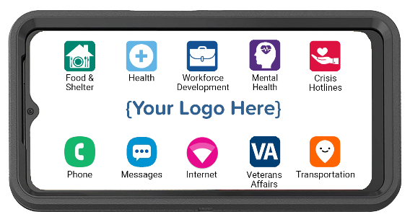
CPR³ enables Veterans to get back to being
productive members of society.
281.667.0404
premierwireless.com

