Slide 1
CPR³ - Connecting People to Resources

Slide 2
Introduction
Our Mission
To Enable Innovation, Communication, Safety, and Transformation through Technology
Our Goal
To provide reliable access to critical resources, improving quality of life and helping people reach their full potential.

Slide 3
Housing Authority Challenges
Housing Authority program administrators need a reliable method to connect clients to available resources including:
Educational tools and resources
Childcare
Workforce development
Employment opportunities
Healthcare
Mental health services

Slide 4
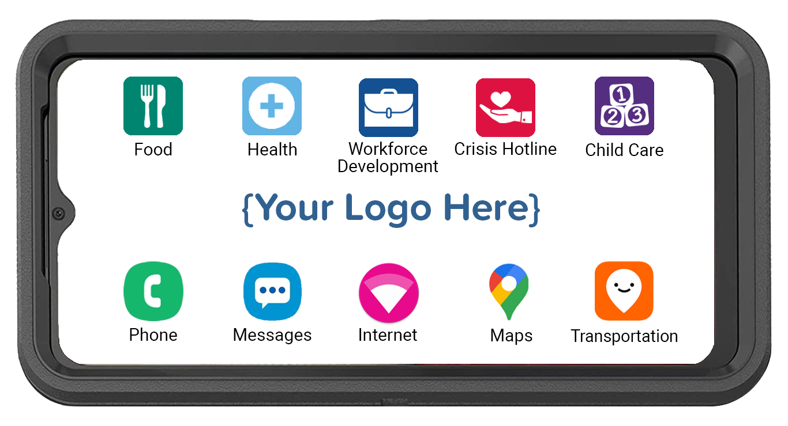
CPR³ Connecting People to Resources Powered by T-Mobile
All-in-one device providing:
Hand-held, body-worn computer
Unlimited communication (voice, text, data & hotspot)
Instant access to resources
An innovative & effective solution for connecting clients to the resources that can change & improve the trajectory of their lives

Slide 5
Customizing Your CPR³ Device
The CPR³ solution is custom-built to provide access to many different resources.
Clients simply tap the icon to access your list of available resources.
Workforce Development
Food
Health
Crisis Hotline
Local food banks
Local churches
Holiday Food Drives
SNAP (food stamps)
WIC
Telehealth
Mental Health
Local Clinics
Prescription Help
Medicaid/CHIP
GED Completion
Trade Schools
College Options
Interview Training
Job Search Engines
Drug & Alcohol
Domestic Violence​
Sexual Abuse​​
Suicide Prevention
Veterans Hotline​
Icons can be an individual app, a link to a webpage or a folder containing multiple apps and webpage links.

Slide 6
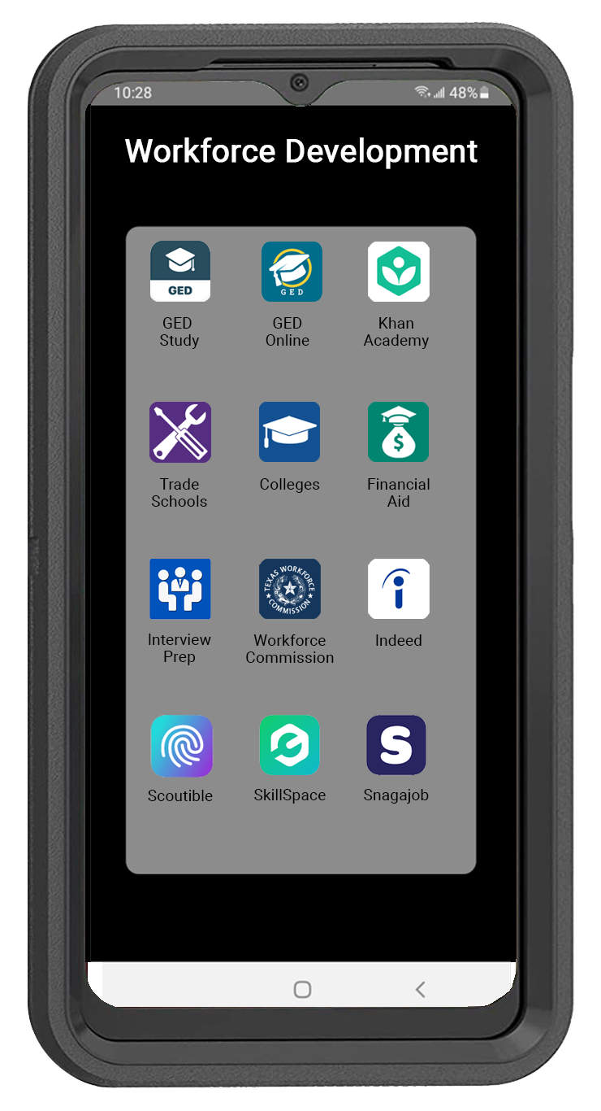
Workforce Development
Clients can easily access all the resources they need to build their skills & find employment opportunities
Turn on the wi-fi hotspot & connect additional devices to the internet via a wi-fi hotspot

Slide 7
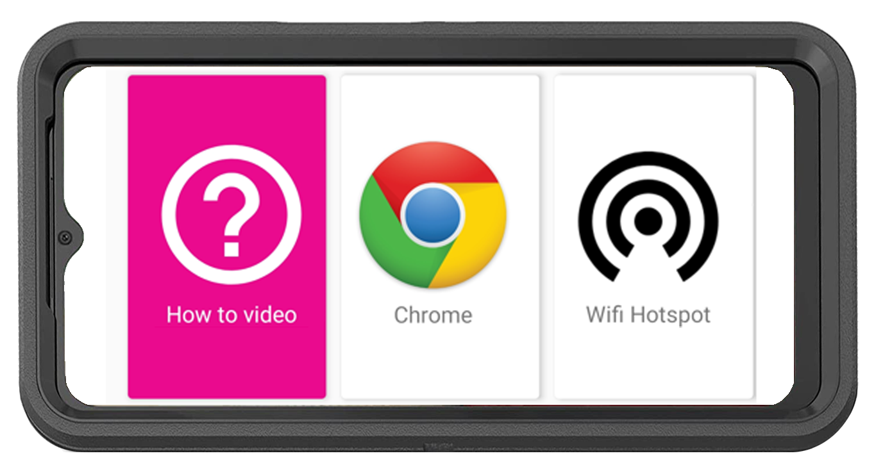
CPR³ Equity & Access
How-To Video with Step-by-Step Instructions to Connect Other Devices to the Hotspot
English
Spanish
Pashto
Farsi
Unlimited On-Screen Data
Unlimited Hotspot Internet Access
Powered by T-Mobile – America’s Largest & Fastest 5G Network

Slide 8
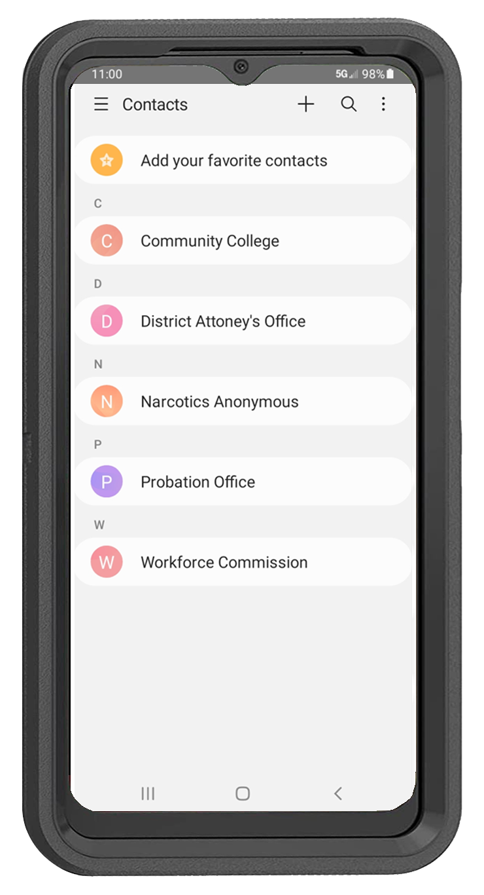
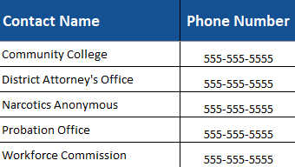
CPR³ Unlimited Communication
Ensure consistent communication between clients and family to decrease isolation and improve support system
Unlimited Calling
Calling to/from US, Mexico or Canada
Unlimited Texting
Easily deploy a resource phone directory to all devices
Easily update phone directory anytime
Ability to restrict calling to/from numbers included in the pre-programmed phone directory

Slide 9
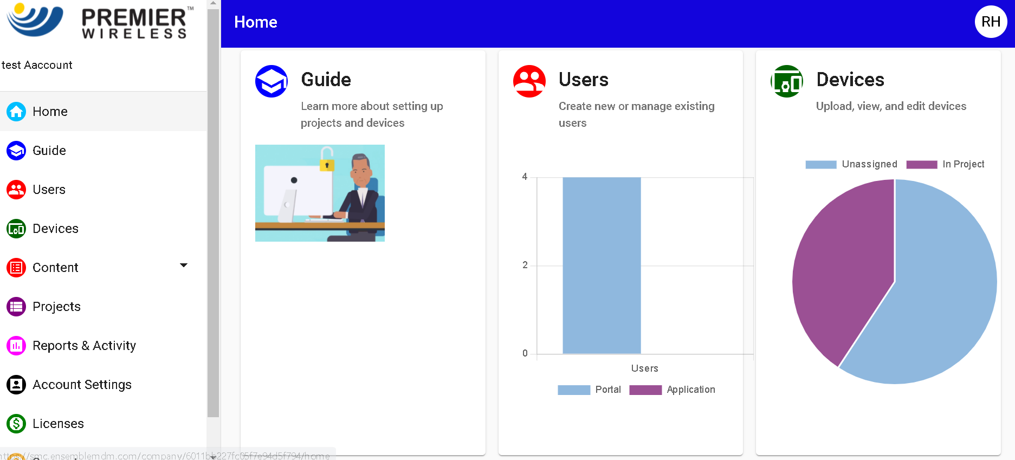
CPR³ Turn-Key 5G Solution with White Glove Support
Smart Device
Rugged Case, Screen Protector & Charger
Initial Device Enrollment
2-Year CPR³ Software License
2-Year CPR³ Portal Admin Support
White Glove Project Management & Post Sales Support
Completely customizable to provide your local resources in the desired language
Remotely add, update or remove apps for food, housing, health, legal & other resources

Slide 10
CPR³ Software Additional Benefits
Easily add or remove apps & links
Customize the look & feel
Personalize with your logo
Manage usage by time & day
Monitor usage per device
Optional CIPA filter for web traffic
Locate devices with GPS (optional)
Restrict user’s ability to download additional apps
Lockdown & restrict lost or stolen devices
Control device settings - brightness, screen time out, font size & color, etc.

Slide 11
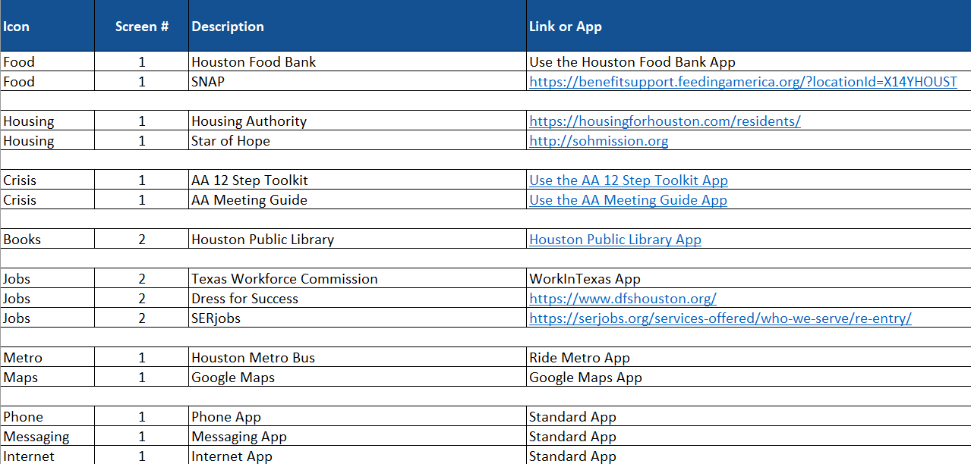
Getting Started
Home Screen
Screens 2, 3, 4, etc.
Provide Premier with a PNG image of your Logo
List the names of the stand-alone apps that will be included in a folder on the master spreadsheet
List the screen number you want each folder or Icon to appear
Add the web links and the apps that correlate to the folder that you want included on your Excel template
Remember, you can add or delete Icons, Apps and Folders at any time

Slide 12
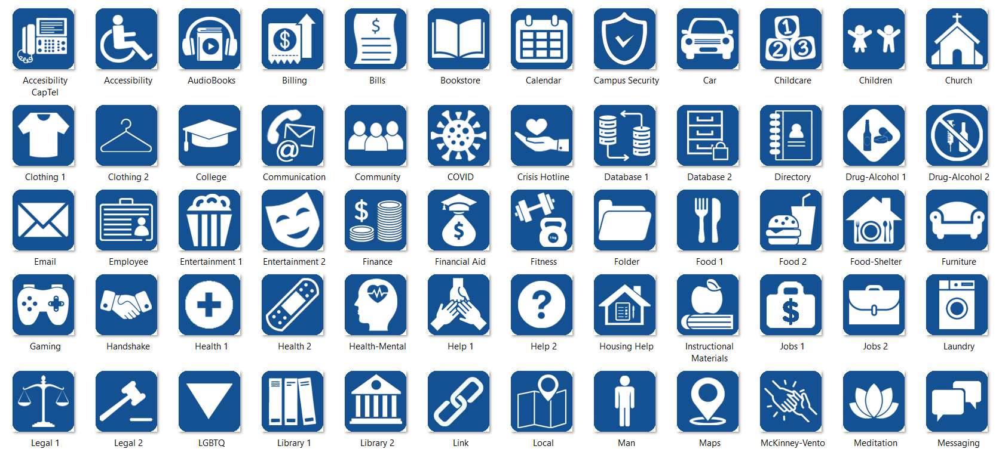
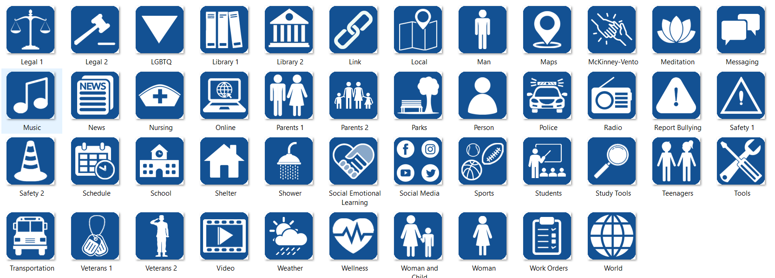
Icon
Examples

Slide 13
Impact of the CPR³
Improves access to critical resources and opportunities to achieve greater success
Empower clients and build confidence with improved job skills, technical skills & overall education
Ensure continuous communication with family and friends
Improve outcomes for success that are necessary to establish stability in the household

Slide 14
Let the CPR³ help your clients reach their full potential.
www.pwbts.net

