Slide 1



Innovative Strategies to Increase
Engagement & Drive Academic Success

Slide 2
Think About the Challenges You Face Daily
High rates of absenteeism
Greater learning gaps
Greater risk of dropping out
Students and families are often less engaged
Family phone numbers change frequently, or they don’t have a phone
Students battle pride & shame and often don’t express their needs
FACT – 84% of MV students want higher education – only 6% complete

Slide 3

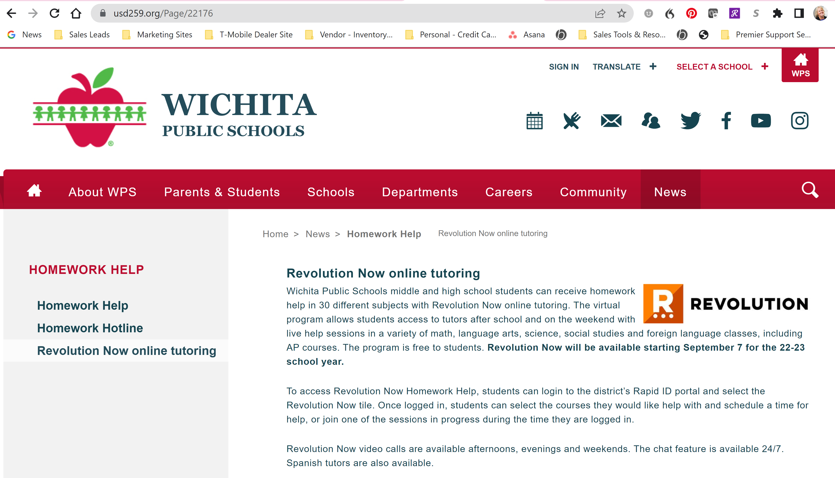

Current Approaches for Communicating
Flyers Websites Telephone

Slide 4
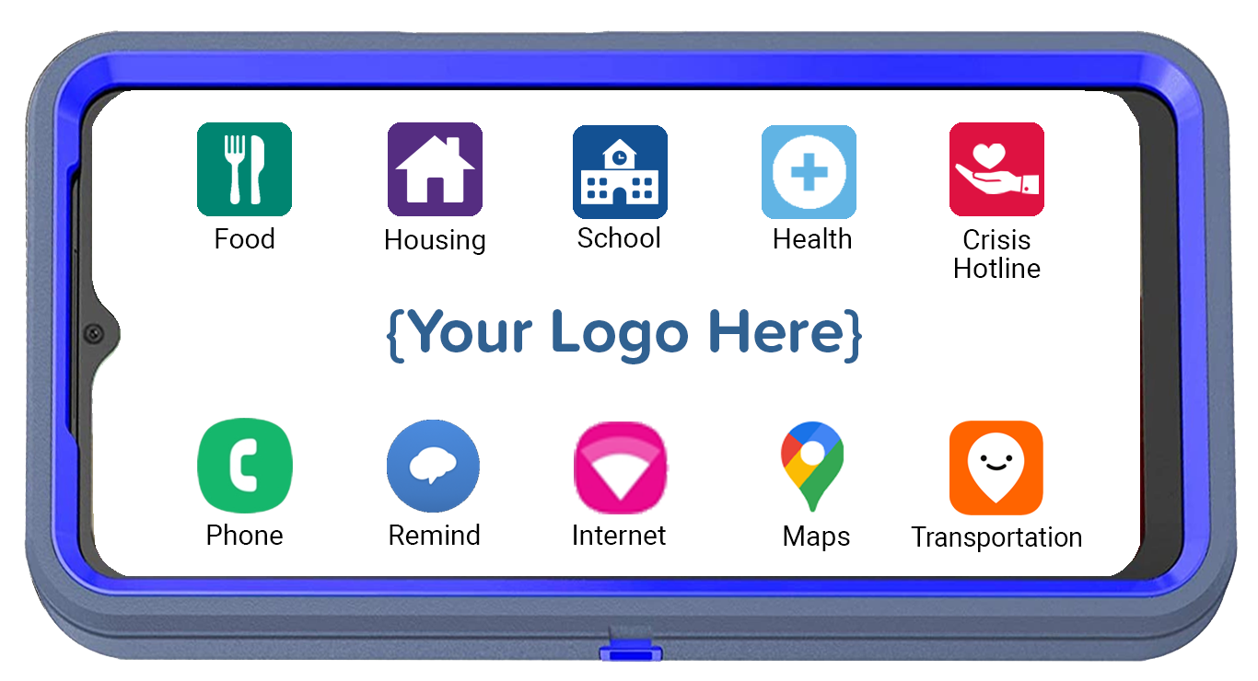
Is There a Better Way to Increase Engagement?
CPR³ – Connecting People to Resources

Slide 5


Layer Cake Approach Increases Engagement & Student Success
Enable Students to Achieve Full Potential
Close Academic Gaps
Meet Students’ Basic Needs

Slide 6





Meeting Basic Needs
The CPR³ solution is custom-built to provide
access to many different resources.
Students & families simply tap the icon and
get connected to available resources.
Food
Housing
Health
Crisis Hotline
Local food banks
Local churches
Holiday food drives
SNAP (food stamps)
WIC
Local shelters
Motel vouchers
Housing assistance
Utility bill assistance
Housing authorities
Mental Health
Telehealth
Local Clinics
Medicaid/CHIP
Prescription Assistance
Suicide Prevention
Sexual Abuse
LGBTQ Support
Domestic Violence
Substance Abuse
Icons can be an individual app, a link to a webpage or a folder containing multiple apps and webpage links.

Slide 7

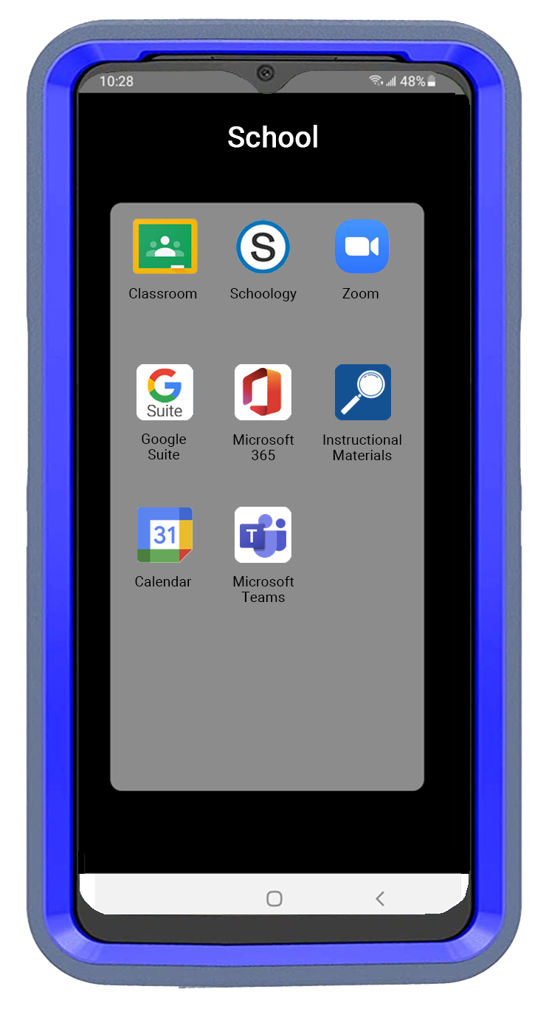

Link to School
Access school apps through your LMS system
Access virtual tutoring
Access other pre-approved apps to help close learning gaps
Enables students to complete assignments anywhere, anytime from the palm of their hand

Slide 8

Level Up to Close the Gaps
Preconfigured to provide everything students need in the palm of their hands
Portable and convenient so students can do schoolwork anywhere
Additional resources to address learning loss
  Virtual tutoring
  Remedial reading
  Remedial math
  Summer school
  Remind app for additional assistance
Help students prepare for their future

Slide 9



Help Students Reach their Full Potential
Career Options
Dual Credit Classes
Vocational Schools
Community Colleges
Universities
SAT/ACT Prep
Scholarships & Grants
VA Benefits

Slide 10


CPR³ Unlimited Internet Access
Provides instant on-screen internet access
Provides a hotspot for up to 8 other devices
Includes a How-To Video with step-by-step instructions to connect other devices to the hotspot. Current languages include:
  English
  Spanish
  Pashto
  Farsi

Slide 11
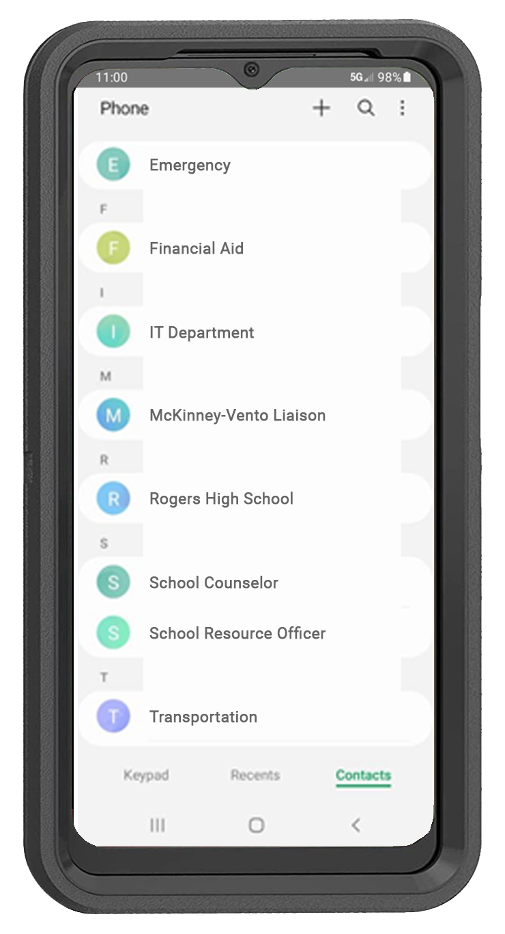


CPR³ Unlimited Communication
Provides the ability to communicate with a stable and consistent phone
Enables students to call transportation with changes
Provides students with a pre-programmed school and community resource phone directory
Easily update phone directory anytime

Slide 12

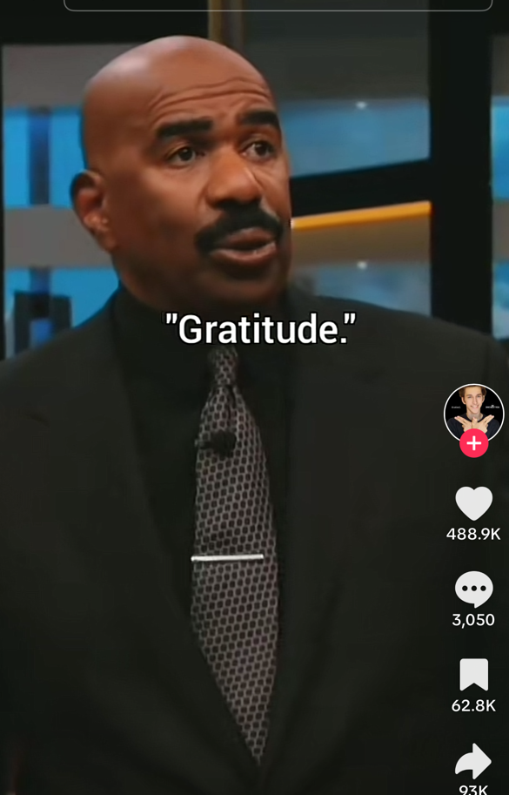

Increase Engagement with Video
Learn Math, Reading & More
Motivate & Inspire
Practice for ESL Students

Slide 13
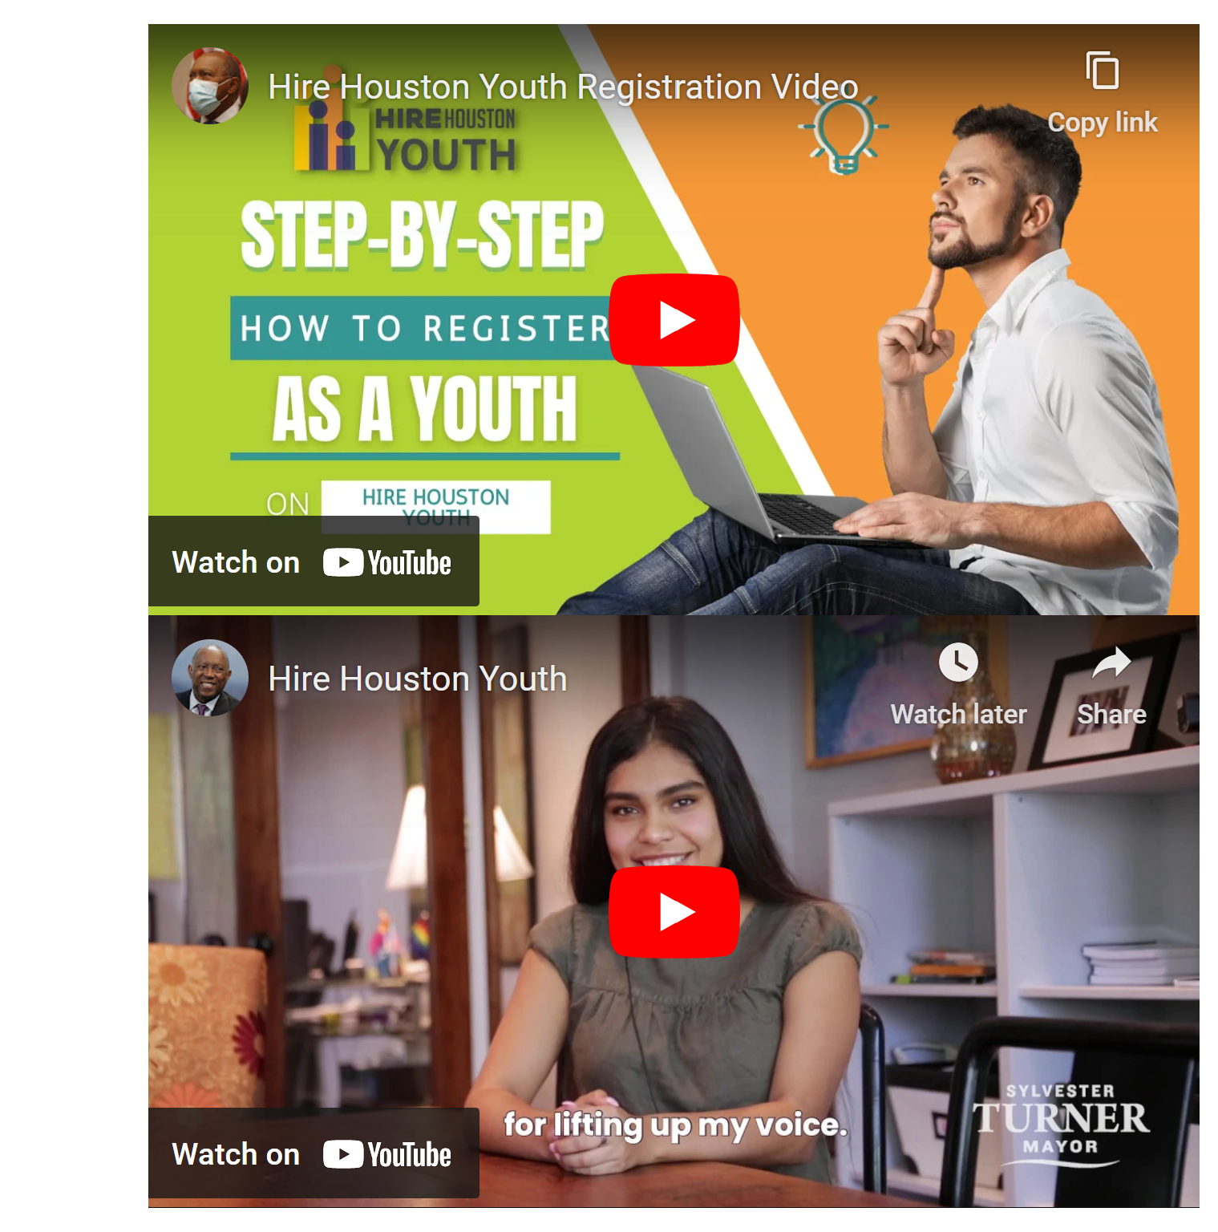

Career & Job Readiness

Slide 14

Getting Started…
Identify:
Your goals
Your gaps
Your challenges
Your desired outcomes

Slide 15

Funding Options
ARP-HCY
ESSER
McKinney-Vento Funds
Title 1
GEAR UP
Trio
Curriculum Delivery
General Funds
Community Partnerships

Slide 16
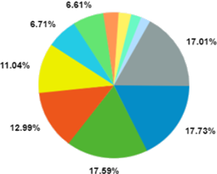
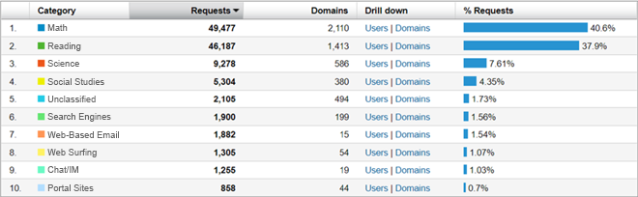
Leverage Data for Clarity, Visibility & Sustainability

Slide 17
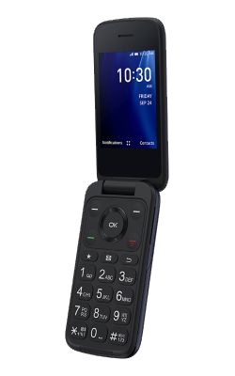
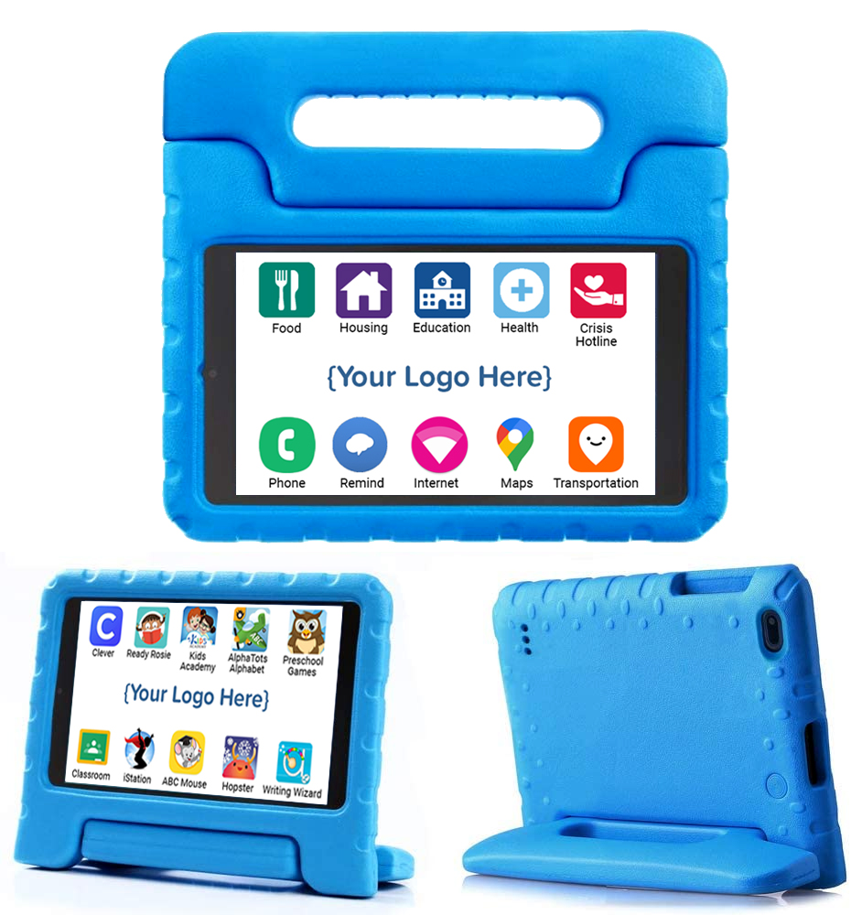
Alternative Form Factor

Slide 18

Impact on Students & Families
Ensures continuous communication with student & family
to increase engagement
  Portable device
  High speed internet access
  Voice & text communication
Protects student and family from societal shame when reaching out for help
Enables students & families to be self sufficient
Decreases isolation & mental health issues with increased communication between school, families & resources
Drives academic results

Slide 19

Let the CPR³ help bring success to your students and their families.
www.pwbts.net 281-667-0404

