Slide 1
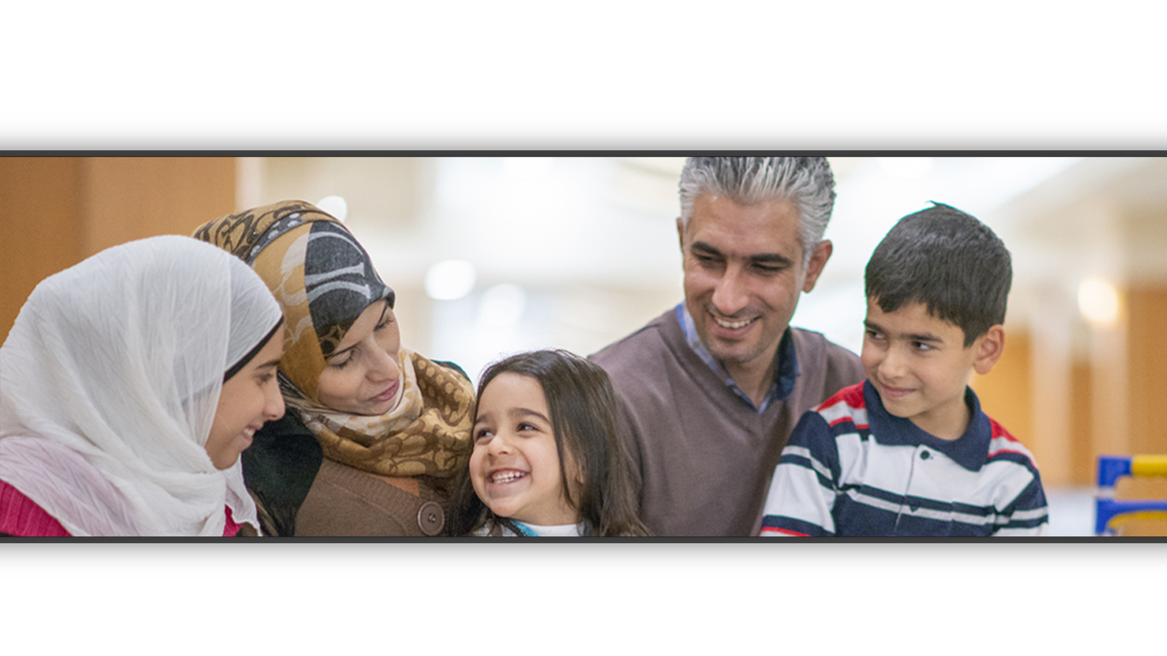
CPR³ - Connecting People to Resources

Slide 2
Introduction
Our Mission
To Enable Innovation, Communication, Safety, and Transformation through Technology
Our Goals
To help refugees access the critical resources they need for daily living and long-term success

Slide 3
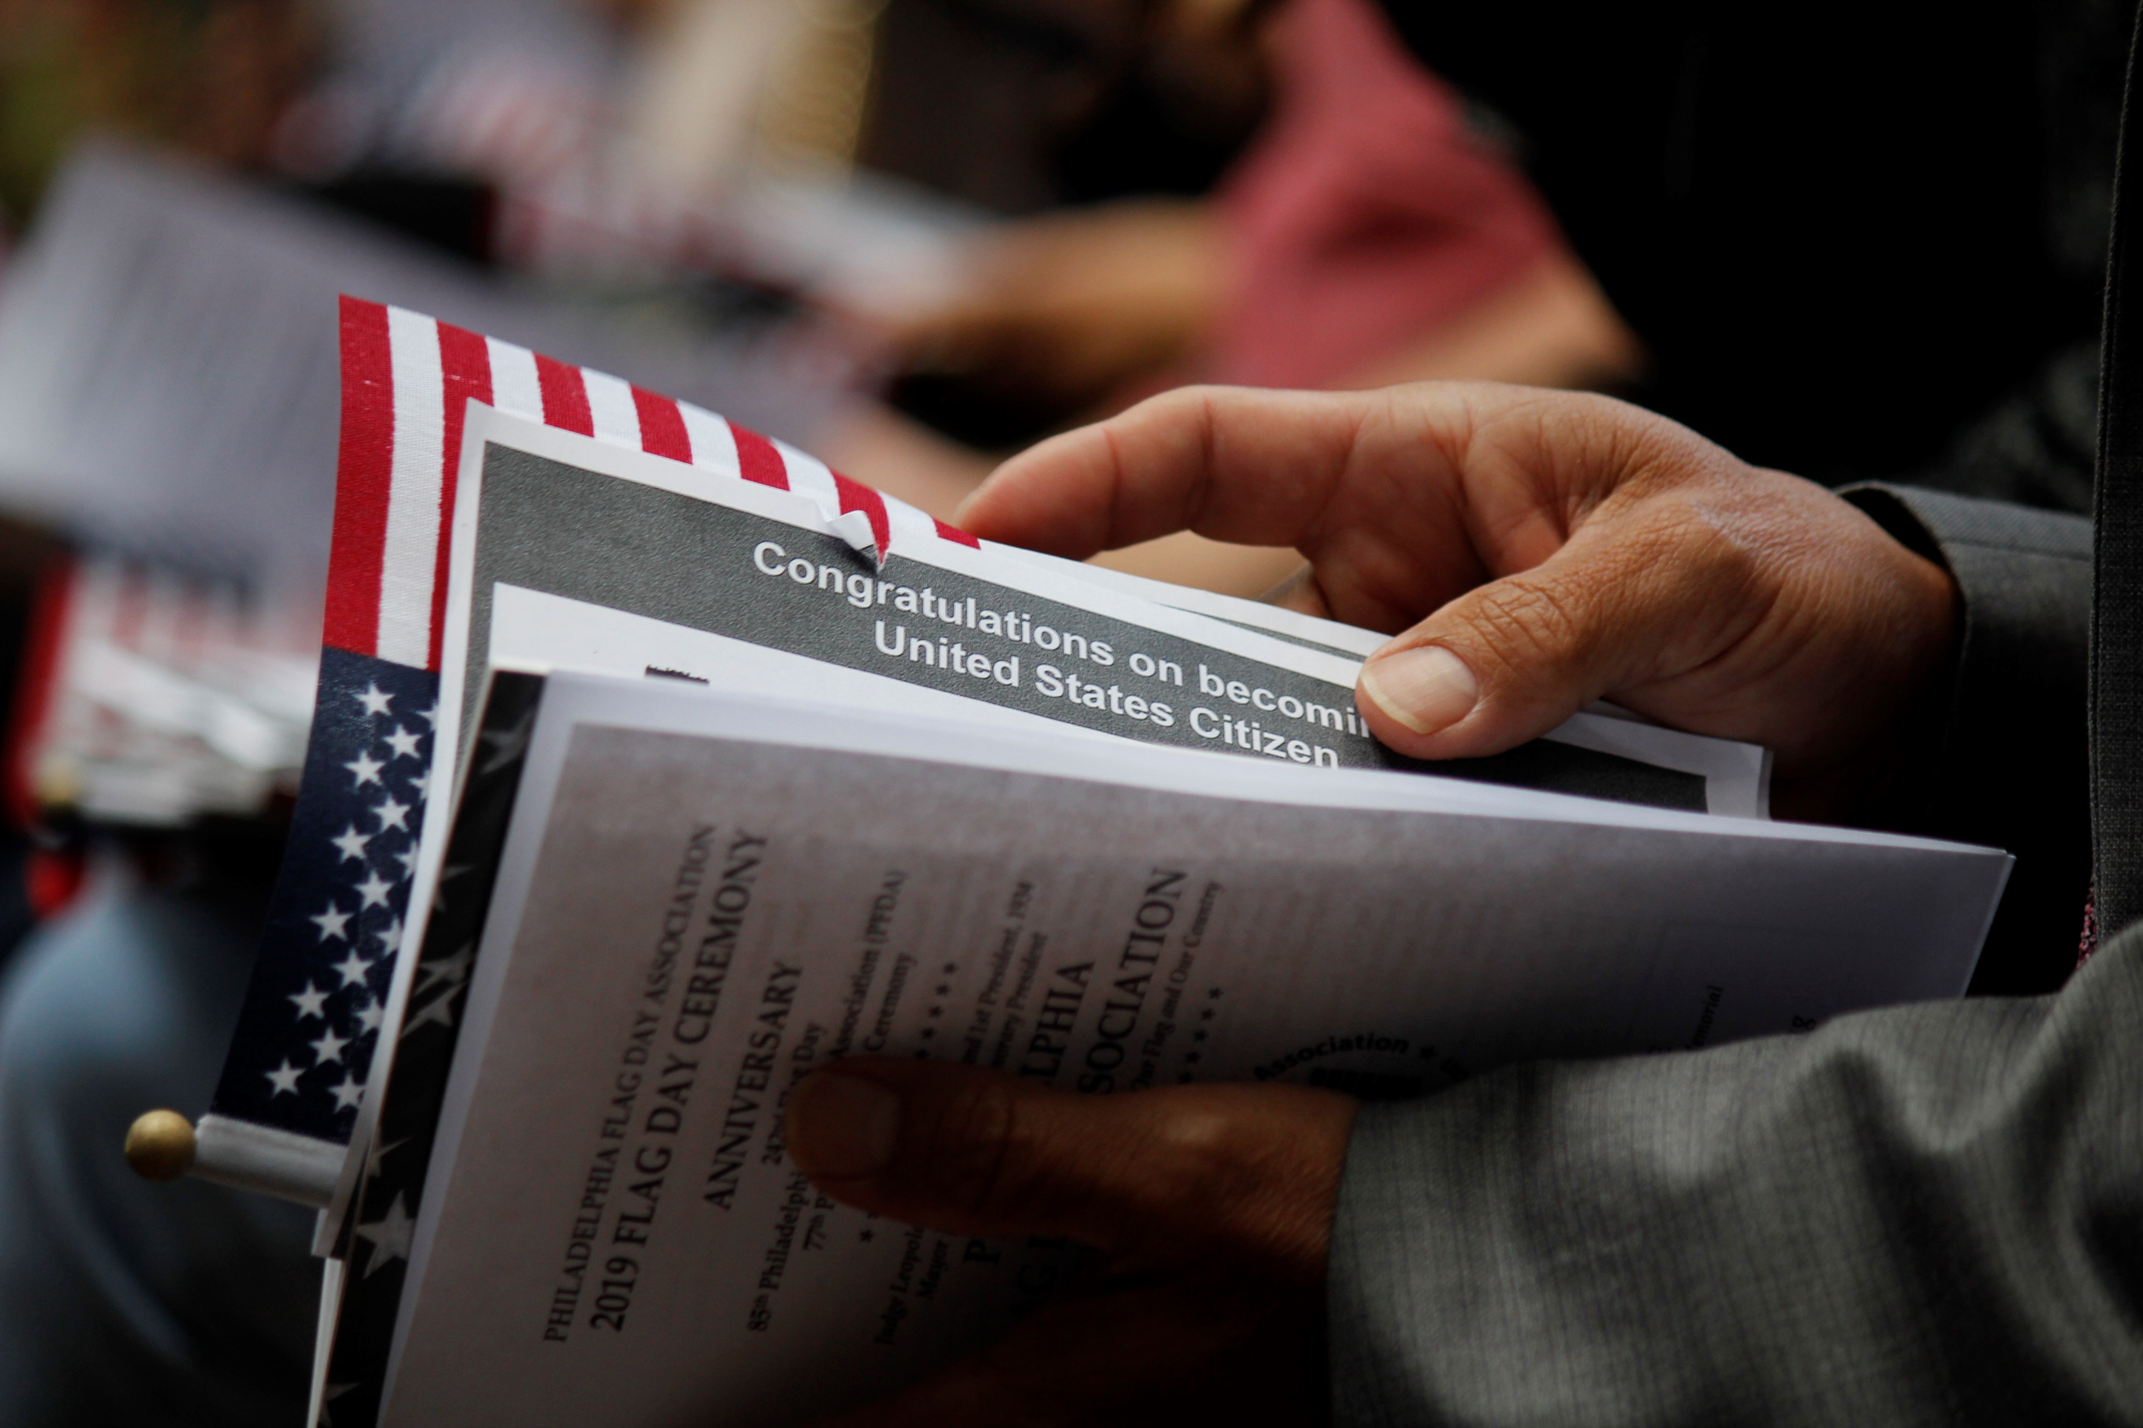
CPR³ – Connecting People to Resources
Resettlement agencies provide refugees and other eligible populations the necessary resources to integrate into the community including:
Initial housing
Employment
Case management
Access to public benefits
Education including learning English
Social and emotional wellness
Women’s empowerment
Financial literacy
Legal help
Transportation
And more
Pride can stand in the way of a refugee asking for help. The CPR³ provides them with immediate access to the resources they need & want.

Slide 4
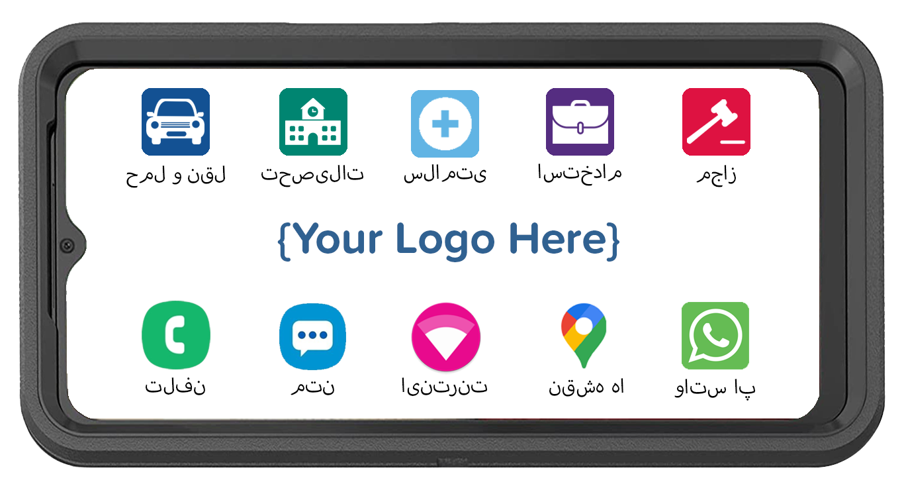
CPR³ Connecting People to Resources Powered by T-Mobile
All-in-one device providing:
Hand-held, body-worn computer
Unlimited communication (voice, text, data & hotspot)
Instant access to resources
Plus, unlimited wi-fi hotspot, connecting up to 10 additional devices to the internet simultaneously
Cost-effective, robust solution for helping refugees connect to critical resources anytime, anywhere

Slide 5
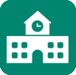
Customizing Your CPR³ Device
The CPR³ solution is custom-built to provide access to many different resources.
Families simply tap the icon and get your list of available resources.
Transportation
Education
Health
Employment
Bus schedules
Taxi
Uber
Lyft
Learning English
Head Start
K-12
Higher Ed
Adult Education
Telehealth
Mental Health
Local Clinics
Prescription Help
Job Search
Skills Development
Worker Rights
Employment Resources
Icons can be an individual app, a link to a webpage or a folder containing multiple apps and webpage links.

Slide 6
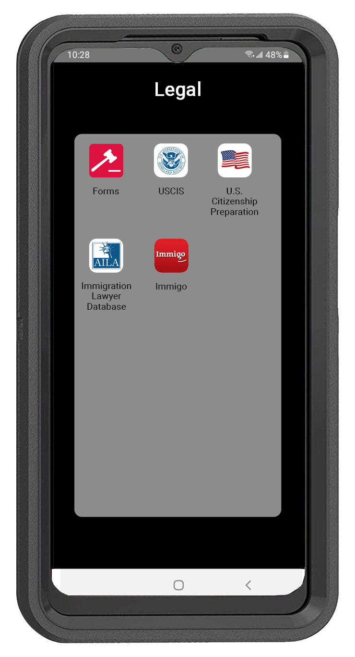
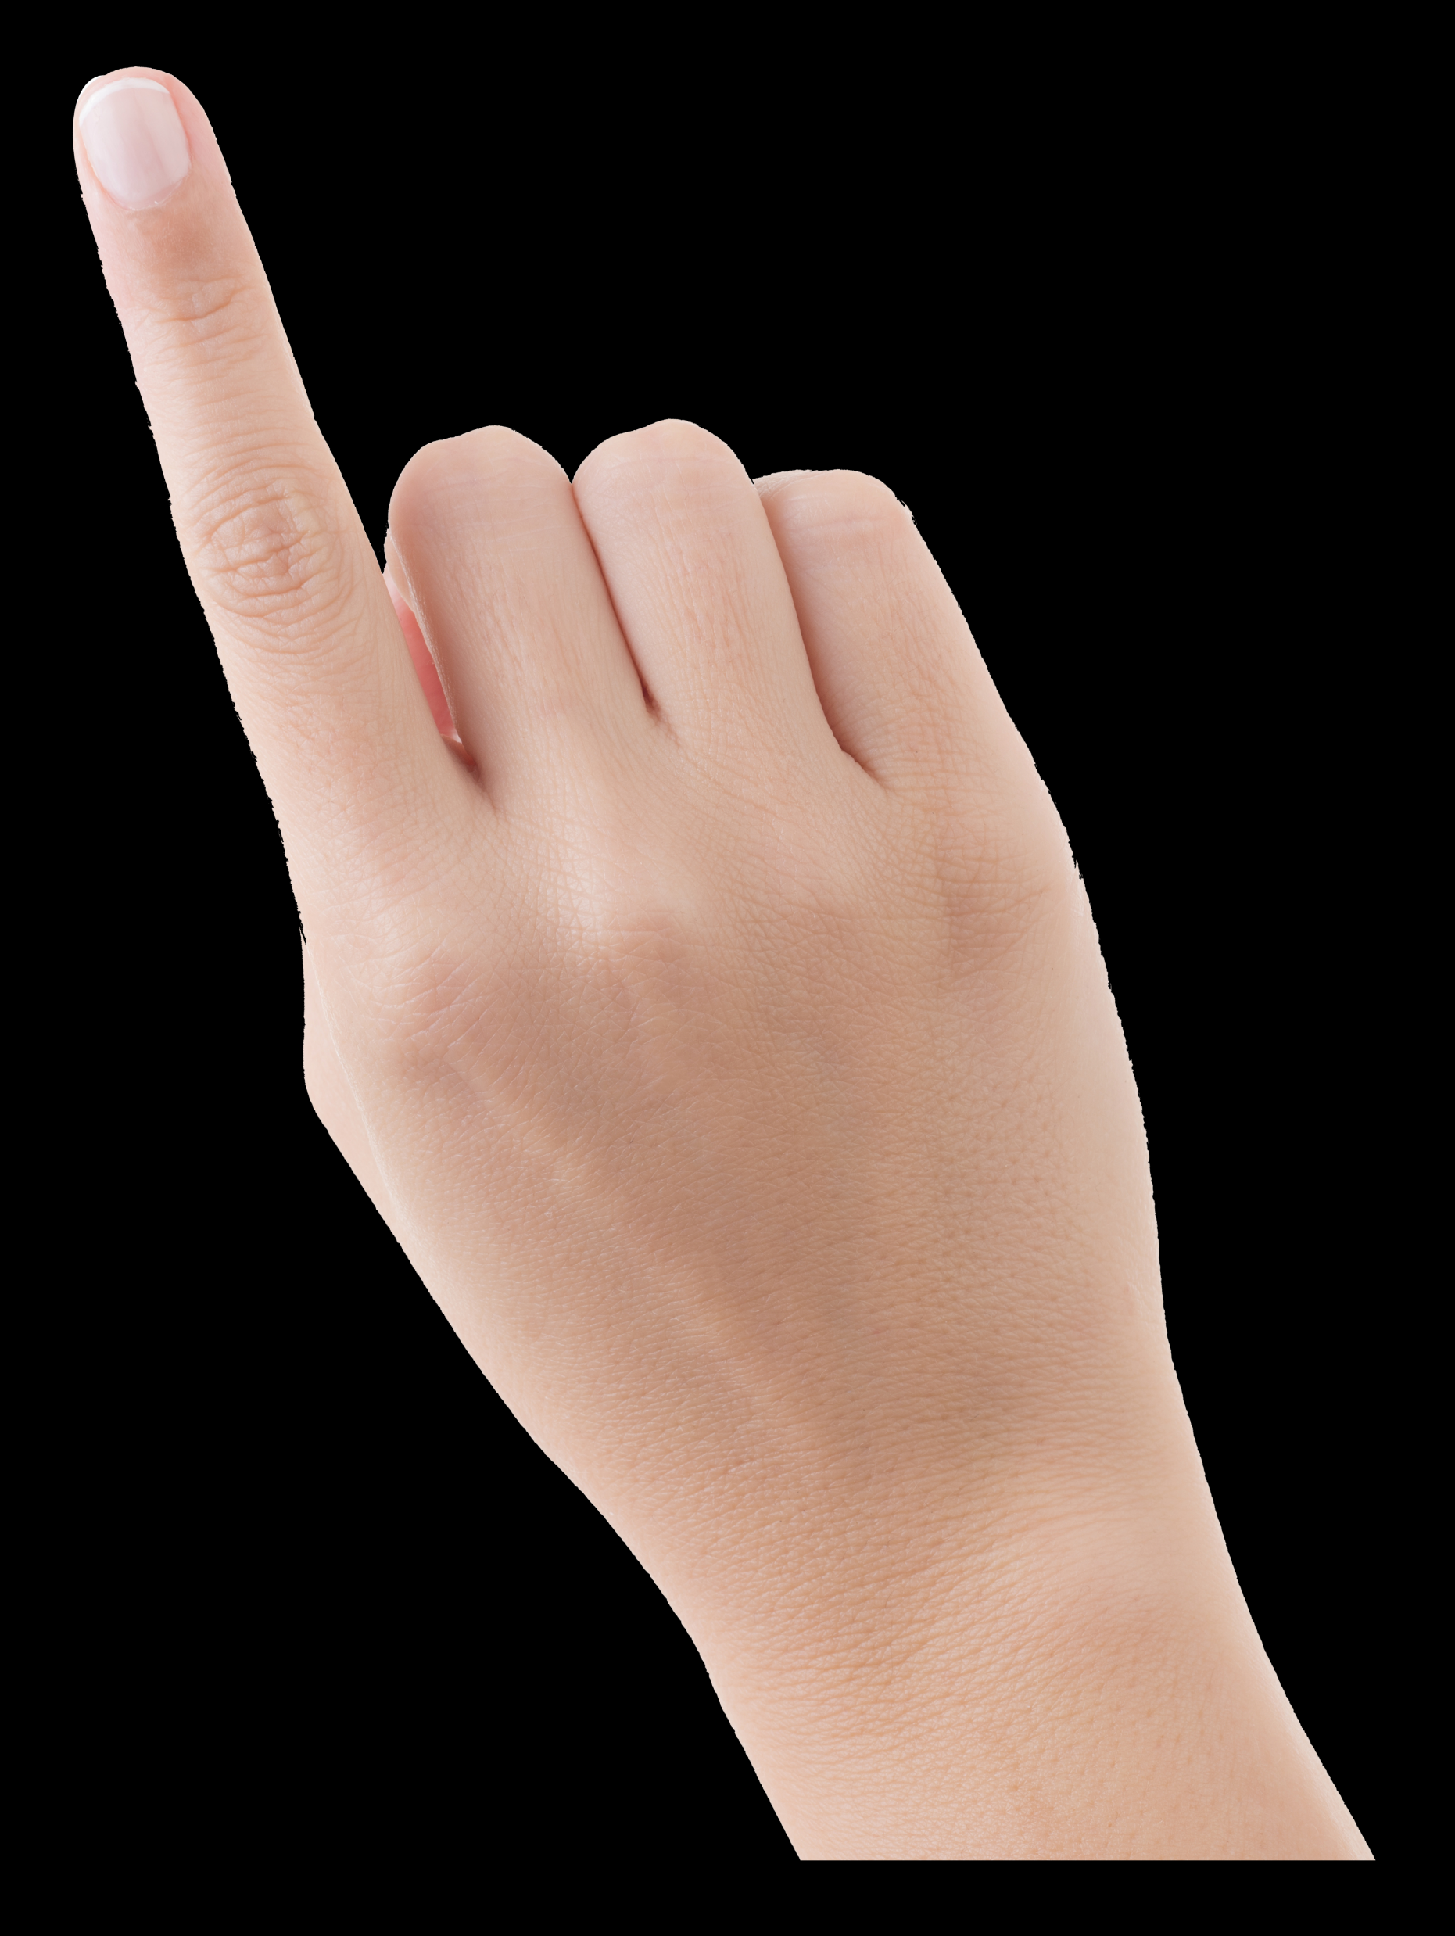
Legal
Enables families to access resources anywhere, anytime from the palm of their hand

Slide 7
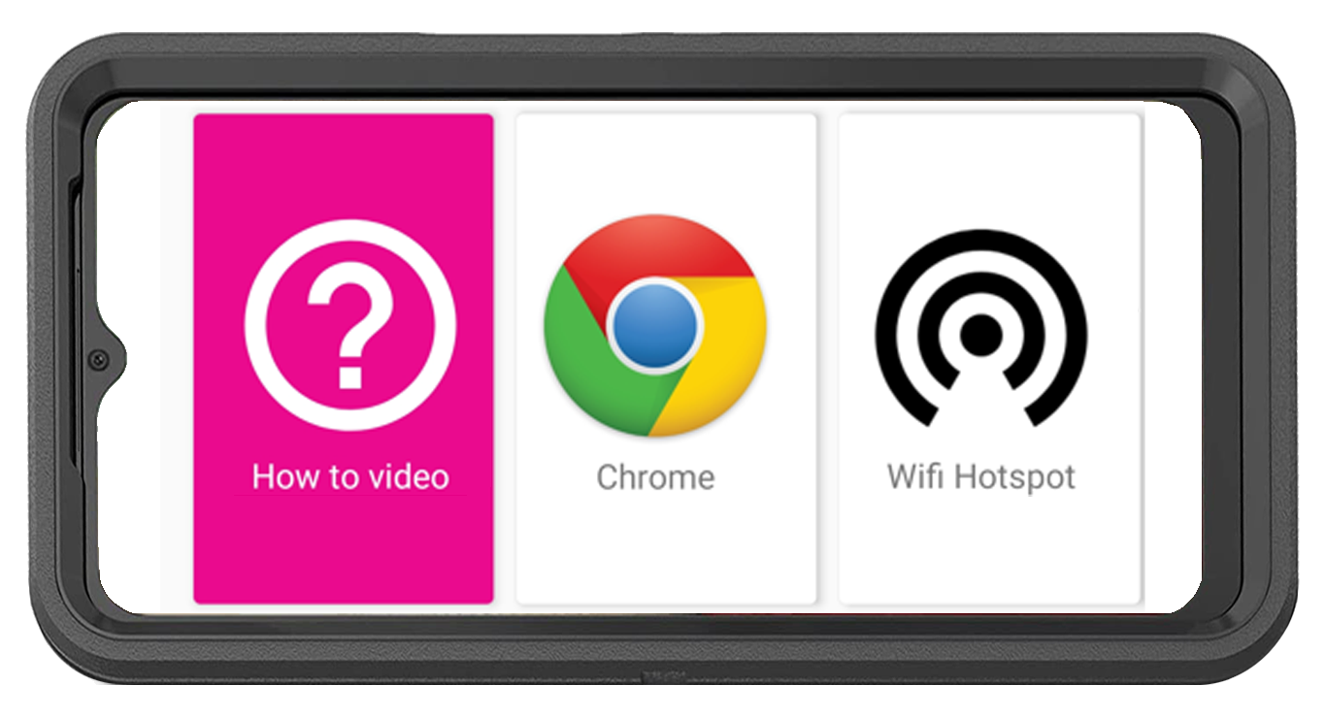
CPR³ Unlimited Internet Access
How-To Video with Step-by-Step Instructions to Connect Other Devices to the Hotspot
English
Spanish
Pashto
Farsi
Unlimited On-Screen Data
Unlimited Hotspot Internet Access
Powered by T-Mobile – America’s Largest & Fastest 5G Network

Slide 8
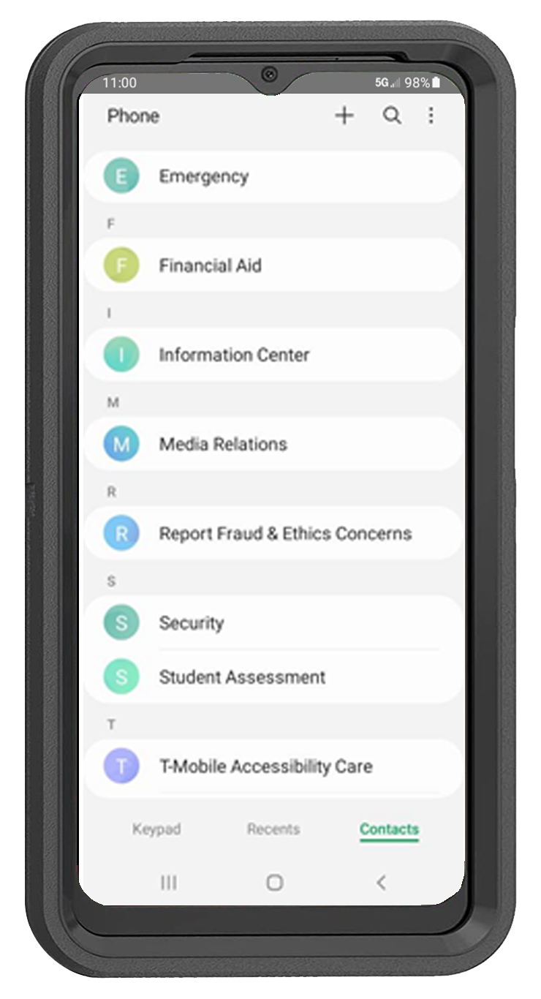
CPR³ Unlimited Communication
Unlimited or restricted calling
Calling to/from US, Mexico or Canada
Easily deploy a school resource phone directory to all devices
Easily update phone directory anytime
Ability to restrict calling to/from numbers included in the pre-programmed phone directory

Slide 9
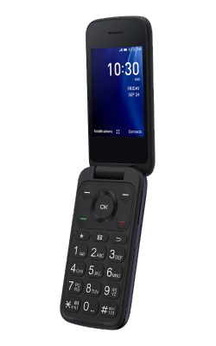
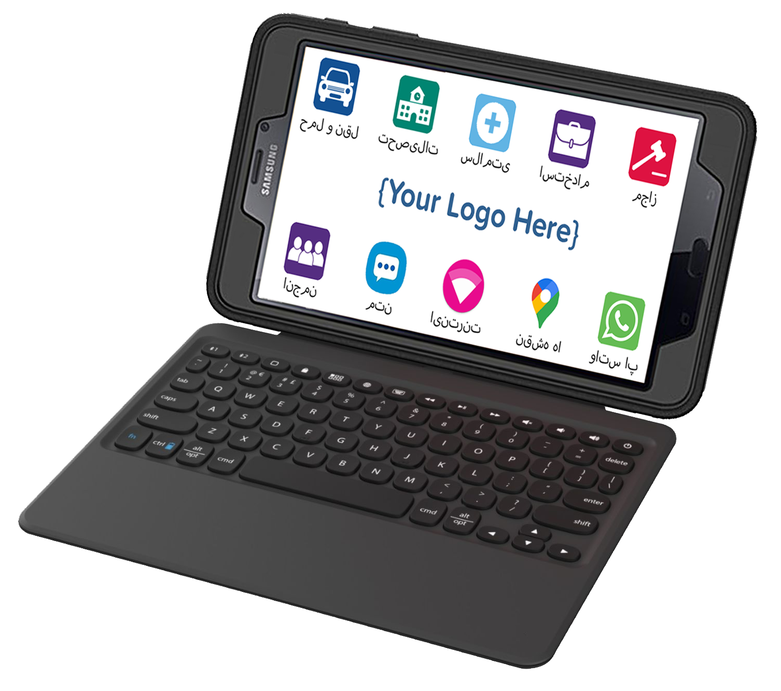
CPR³ Tablet & Phone Bundle Option
Sometimes two devices are better than one

Slide 10
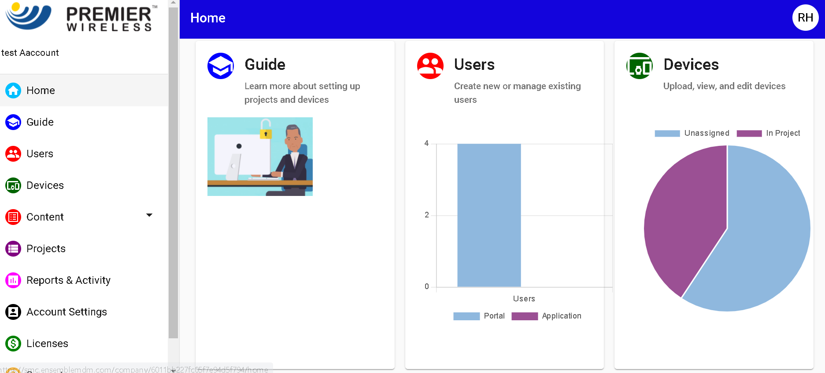
CPR³ Turn-Key 5G Solution with White Glove Support
Smart Device
Rugged Case, Screen Protector & Charger
Initial Device Enrollment
2-Year CPR³ Software License
2-Year CPR³ Portal Admin Support
White Glove Project Management & Post-Sales Support
Completely customizable to provide your local resources in your selected language(s)
Remotely add, update or remove apps for educational programs, health, nutrition, housing & other resources

Slide 11
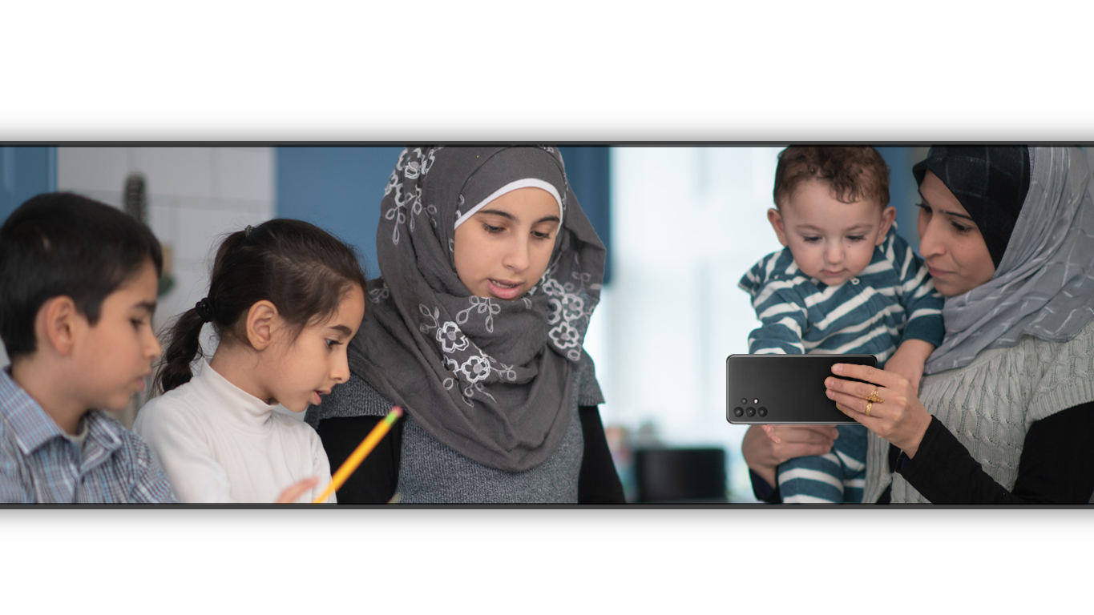
Let the CPR³ help bring success to your refugees and their families.
www.pwbts.net 281-667-0404

