Slide 1

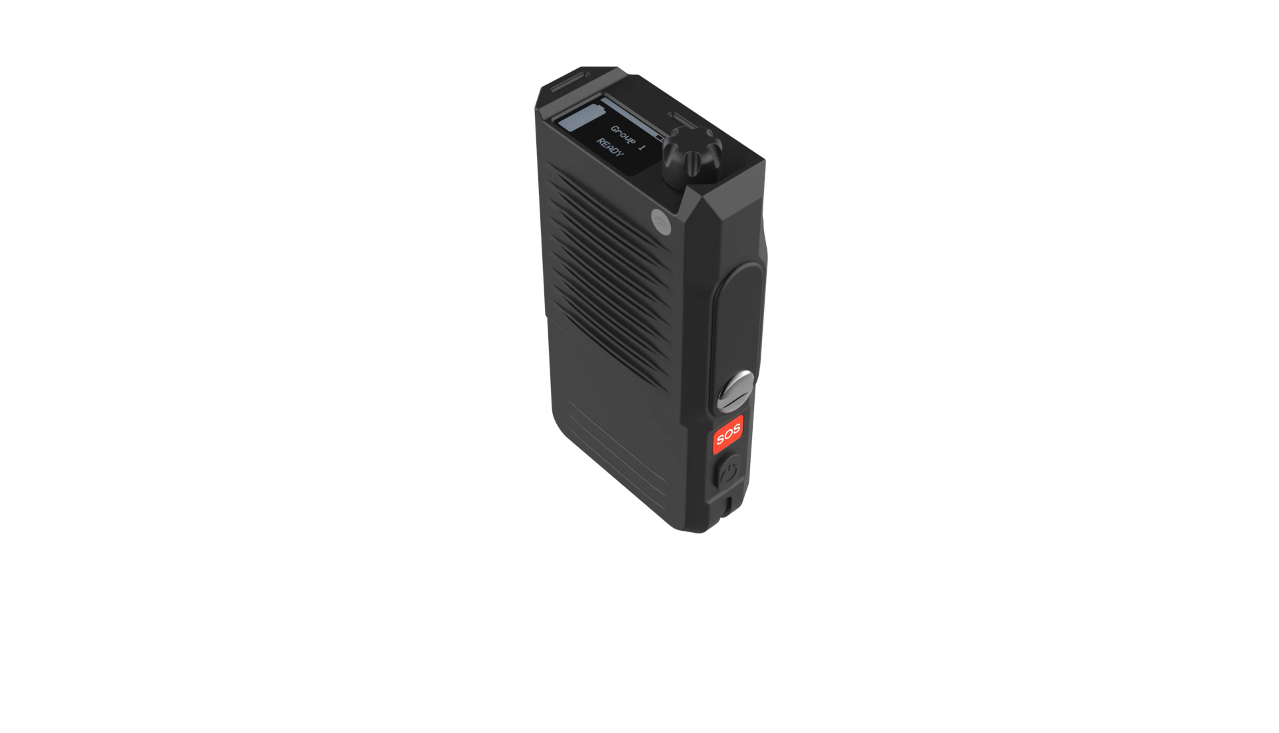


(watch the video above)
Notes:
Basic overview
Rate Plans
Ordering
Provisioning/activation

Slide 2

Who is Siyata Mobile Inc?
NA OEM who designs and develops innovative cellular solutions for Government and Enterprise customers; Focused on Push-to-Talk over Cellular
Also sell Uniden UV350 In-Vehicle device
HQ in Montreal; R&D in Israel
Publicly traded on NASDAQ (SYTA)
https://www.siyatamobile.com
https://siyata7.com

Slide 3
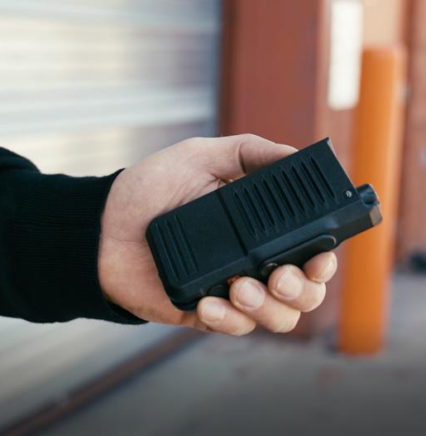
Value Proposition of
Siyata SD7 PTT Handset​
Enables co-workers to communicate easily and efficiently, even if they are past two-way radio users.
Delivers all the benefits of PoC for customers that don’t need phone calls or smartphone features.
A Perfect Upgrade from LMR

Slide 4


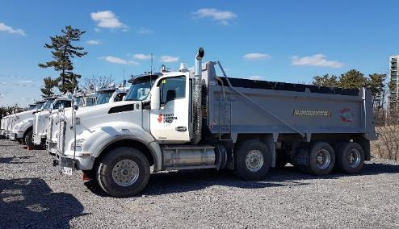

Industry & Verticals for Siyata SD7
First Responders
Public Sectors
Government Agencies
Military
Security
Healthcare-Hospitals
Education
Airline & Ground Transportation
Hospitality
Retail
Manufacturing & Warehousing
Transportation & Logistics
Private Security
Energy & Utilities
Snowplows, Municipal Vehicles
School Bus & Mass Transit
Utility & Construction
Private Security

Slide 5
Problems that Siyata SD7 Solves
Problem | SD7 PTT Handset | Description
Hard to stay connected in LMR radio dead spots | Easy to collaborate | Enables co-workers to communicate easily and efficiently via cellular or Wi-Fi
Hard to justify ROI of communications system | Easy to afford | Cost effective, and optional VK7 Vehicle Kit gives you optimal in-vehicle solution with SD7
New Smartphones are complex to use | Easy to adopt | For former two-way radio users, there is no learning curve using SD7 with a familiar PTT Button, rotary knob for channel changing
Workers waste time using non-work-related apps | Easy to focus | Workers are not distracted with other apps & functionality on their device
IT resources needed to manage Smartphones | Easy to manage | Organization does not need to add an MDM to limit functionality on the device
Poor reliability of devices | Easy to maintain | Meets Mil Standard & IP rugged ratings, and has a swappable battery, backed by 2-year comprehensive warranty

Slide 6
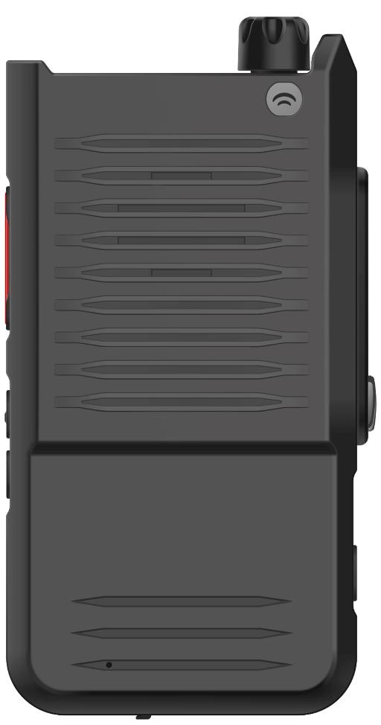
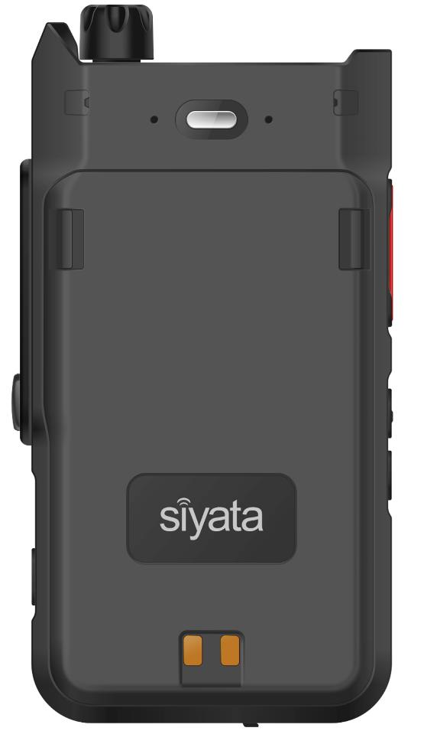
Front & Back
Rotary Channel
Selector
Flashlight
Speaker
PTT Button
Locking Battery Release
13-Pin Secure Connector
Replaceable 3800 mAh Battery Pack
Volume Buttons
SOS Button
Power button
Charging contacts
Notes:
Jason will review device

Slide 7
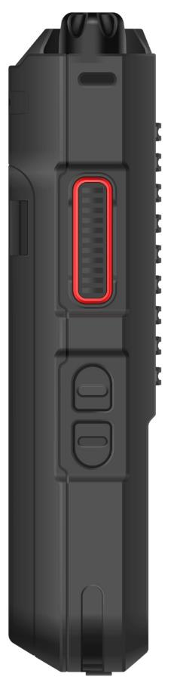
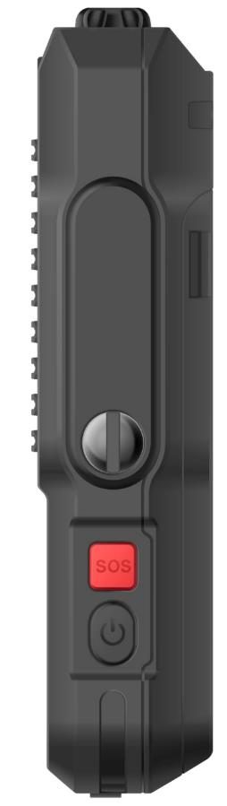
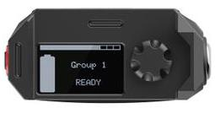
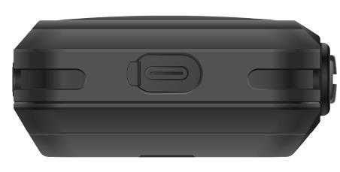
Sides, Top & Bottom
5-way Rotary Channel Selector
Lanyard Loop
LED indicator
PTT Button
13-Pin Secure Connector
OLED Display showing selected Channel/Group/Zone + Battery
USB Type-C
Volume Buttons
SOS Button
Power Button
Notes:
Jason will review device

Slide 8

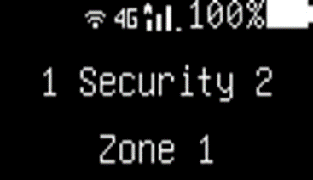
OLED Display & Rotary Knob
Knob rotates left and right = change Talk groups or zones
Press down left & right (default volume up & down)
Click down = select or click on/off
Long press = back one menu level

Slide 9







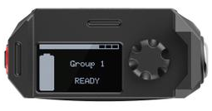










OLED Settings Menu
Exit: Menu or Long Click on the Rotary Knob to back out of the Settings Menu
CrisisGo: Only Shows Installation
Optional Screen: Device name is editable or can be removed from the menu list
PTT: Scan, Ch. Announcement, Tones, use WI-FI, PTT Name & Number
Zones: Switching EPTT Zones
About: IMEI Info (1&2), SW Version, HW Version, etc.
Idle screen
Flashing: High & Low Settings
Support: Device ID used for Provisioning PTT Application & WIFI
Network: Cellular, Bluetooth, WIFI NFC & APN
SOS: Automatically Connects to EPTT (Advanced); Default is Pre-Programmed Text Message sent to 3 Phone Numbers - Requires Manual Set-up
Location: On/Off
System: Device Name, Screen Orientation, Programmable Keys (volume, Channel up/down) & Device Alerts
Audio: Media, Ring, Alarm & Call Volume Adjustments
Convert: Disables Screen, LED Indicator & Speaker
– PTT Accessory must be used for all Audio Output

Slide 10

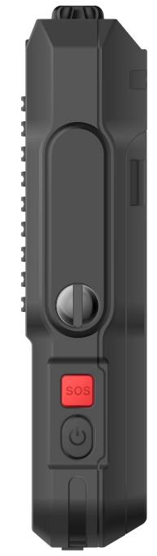



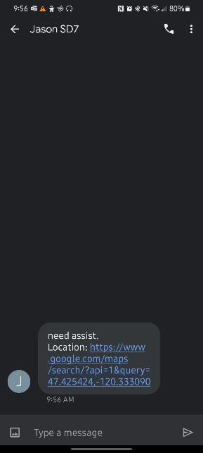
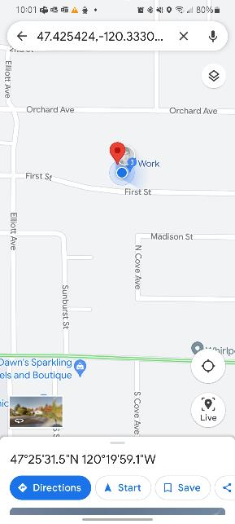





Emergency SMS (manually set on each device)
*Requires Feature Phone Plan with SMS Enabled

Slide 11





COVERT Mode (available in Oct MR)
Click to “On”
To EXIT Covert Mode press the power button. Scroll though power setting until
Long press on power button until “Power Off” shows on screen.
Scroll from Power Off to ‘Restart’, to ‘Airplane mode; then to Exit Covert Mode. Click Down
Screen will black out.
WIRED PTT Headset/RSM MUST be used for all audio and channel announcements. PTT button is functional
During Covert Mode OLED screen and LED Notification will be blacked out
OLED will wake up and return to main idle screen

Slide 12
MCPTT: SD7 is the ONLY feature phone that is MCPTT Compliant
SD7: 3GPP Rev. 12 – supporting MCPTT QCIs 65, 66, 69, 70
SD7 Features
Quectel SC66 module
Qualcomm SDM660 Octa-core, 1.8GHz
Siyata customized Android 9.0 AOSP
3GB RAM + 32GB ROM
3GPP Release 12 (MCPTT ready)
QCI-65, QCI-66, QCI-69, QCI-70
Support for Dual Nano-SIM cards
25 mm OLED – 128 x 64
2.5 Watts speaker for loud, clear audio ≈115 dB
13-Pin Secure Connector for various accessories – wired RSM
5-way rotary knob for easy channel selection (PTT) and volume control
PTT button
Volume rockers
Programmable SOS button tied to PTT services
3800 mAh removable locking battery pack for quick and easy battery replacement
IP68, water & dust resistance
Military Standard 810H, anti-drop 1.5 meters
Rubber molding on top and bottom corners for better drop protection
Charging contacts for bay-charger, VK7 vehicle kit
Available accessories include belt clip, pouch, headsets, RSMs, 6-bay charger
Notes:
Gidi to review the features
We want them to know that this have the “brains” of a smartphone minus the screen

Slide 13
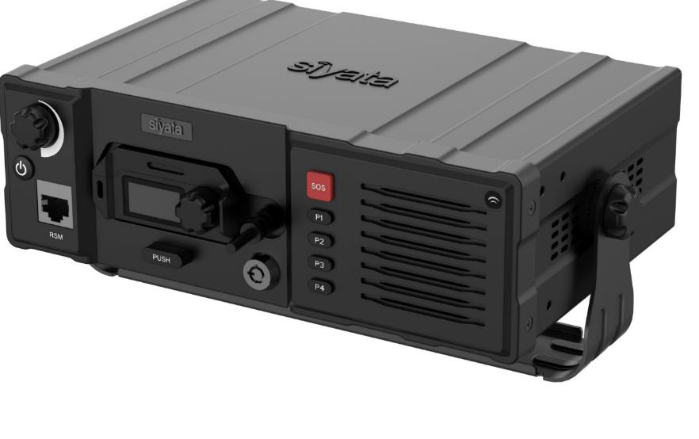
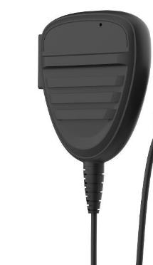
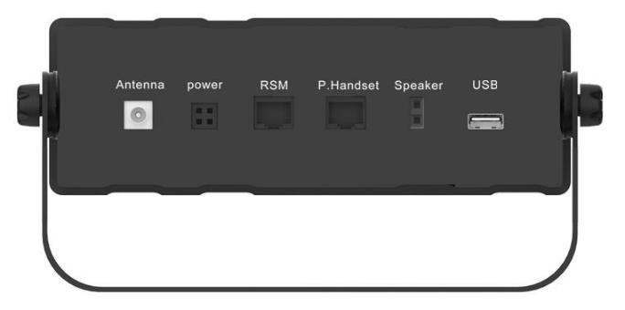
Vehicle Kit: VK7
  Connected to vehicle power
  Integrated 10W speaker
  Modularity allowing multiple accessories solution
  Simple SD7 Slide-In connection
  Charges SD7 battery
  External antenna connection for glass/roof mount antenna, also connecting FirstNet certified in-line booster – UM2M FN Hero (FCC certified).

Slide 14
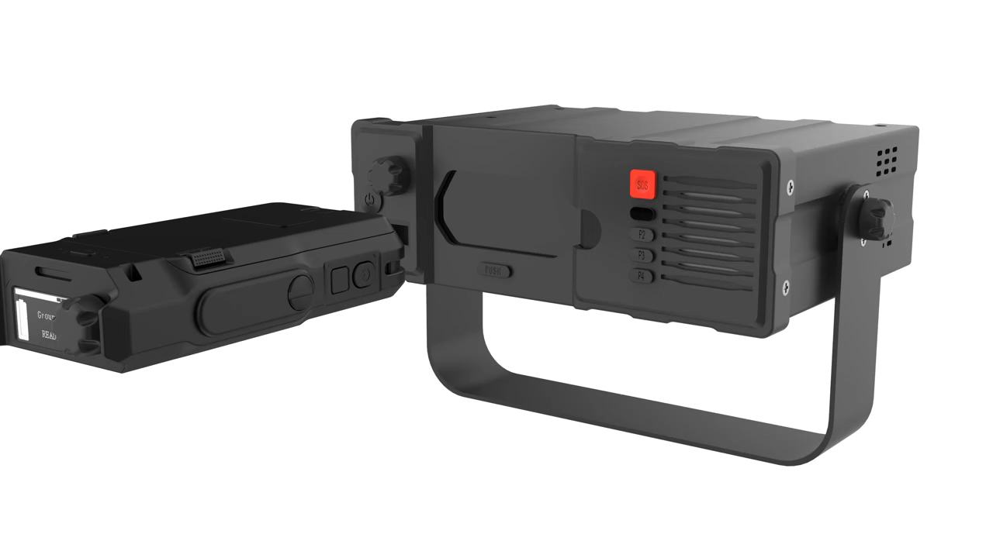

Slide 15
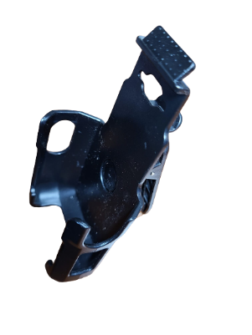
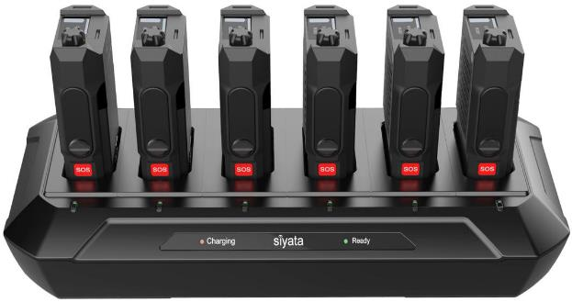
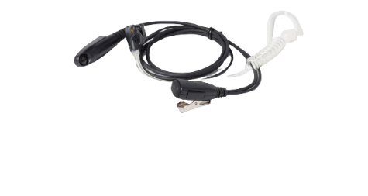
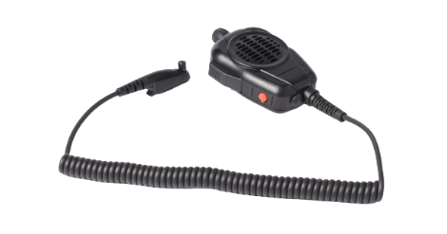
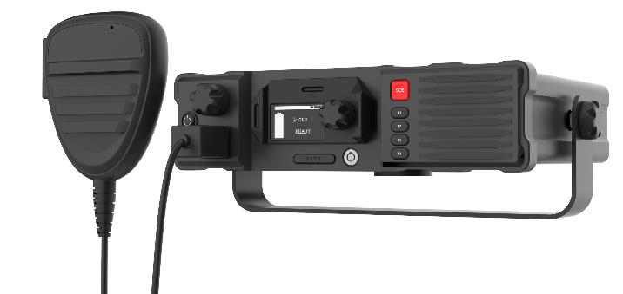
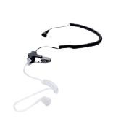
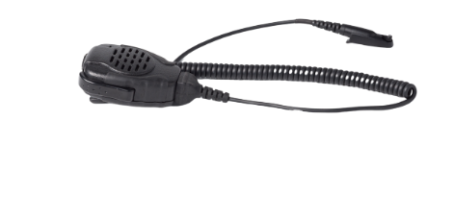
Accessories
Multi-Bay Charger X6
Belt Clip
Wired Palm Mic RSM with Channel knob, SOS, and volume rockers
Private PTT Headset
Vehicle Kit – VK7
Acoustic Tube Surveillance Earphone: LISTEN ONLY acoustic tube earphones with TWIST CONNECTOR for MP60
Wired Palm Mic RSM 3W

Slide 16
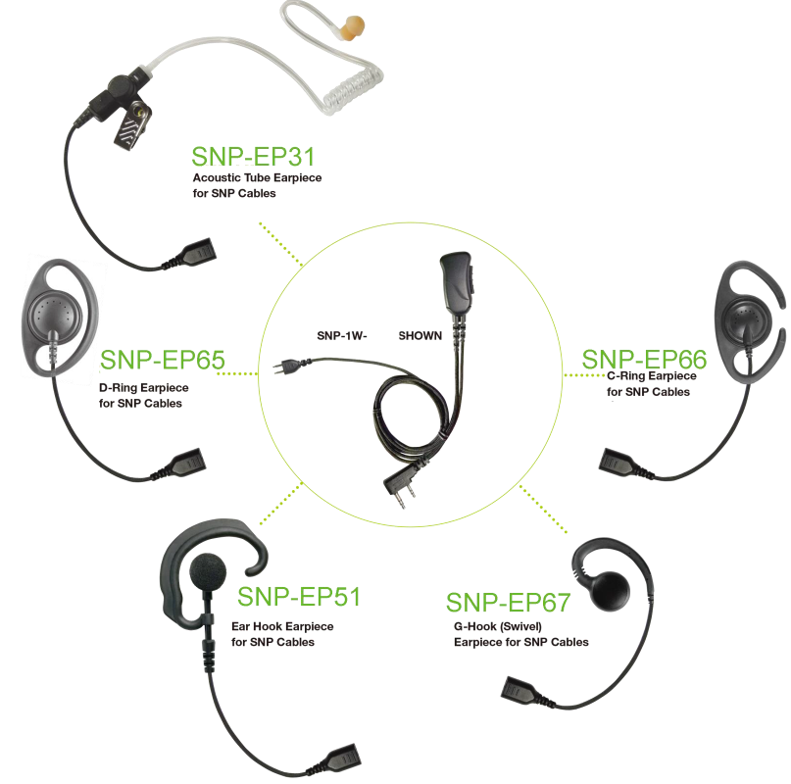
SNAP Series: NEW PTT Headsets
The new SNAP series allows organizations to pick & choose the headset based on user preference and allows easier sharing of SD7 without sharing the headset.

Slide 17
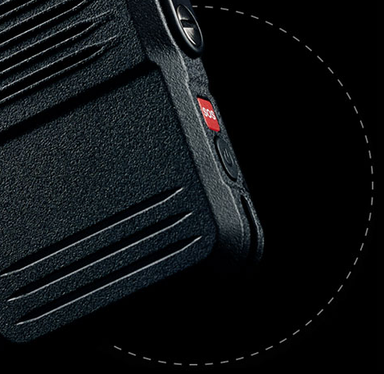
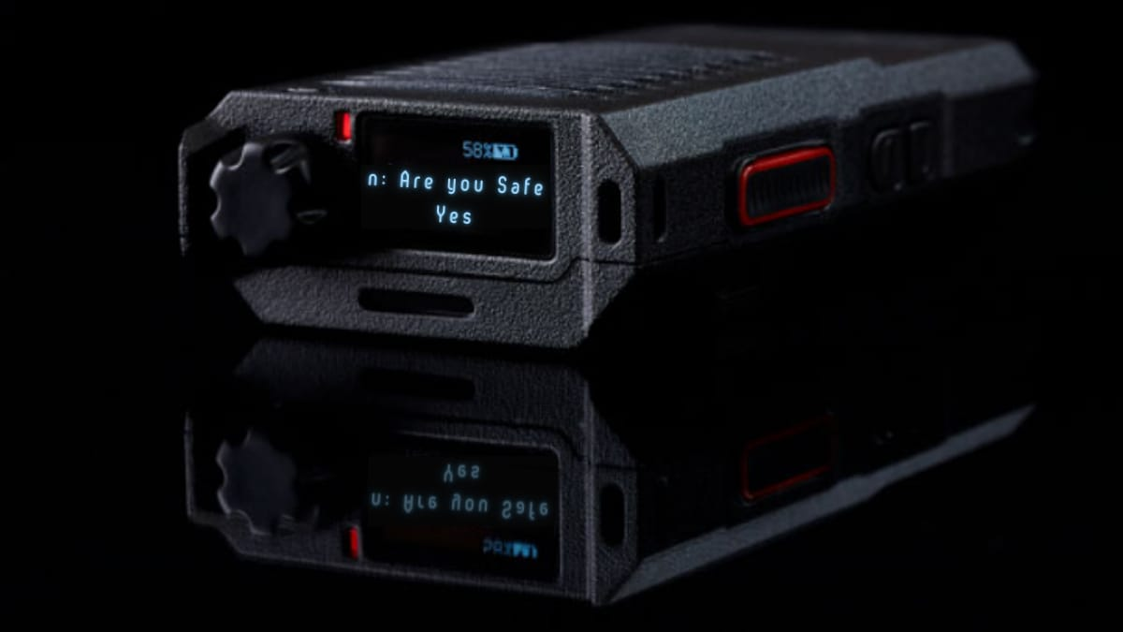
Introducing the Next-Gen
Panic Button with Push-to-Talk
Immediately communicate with other staff members, security, and first responders with PTT.
Send and receive staff assists and lockdown alerts with an integrated SOS button in seconds.

Slide 18
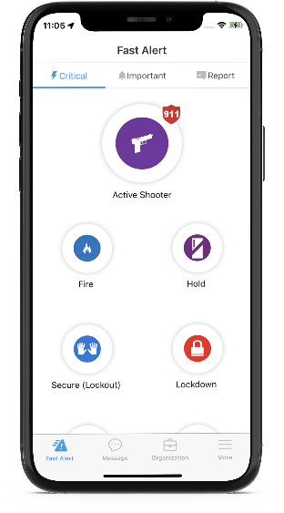
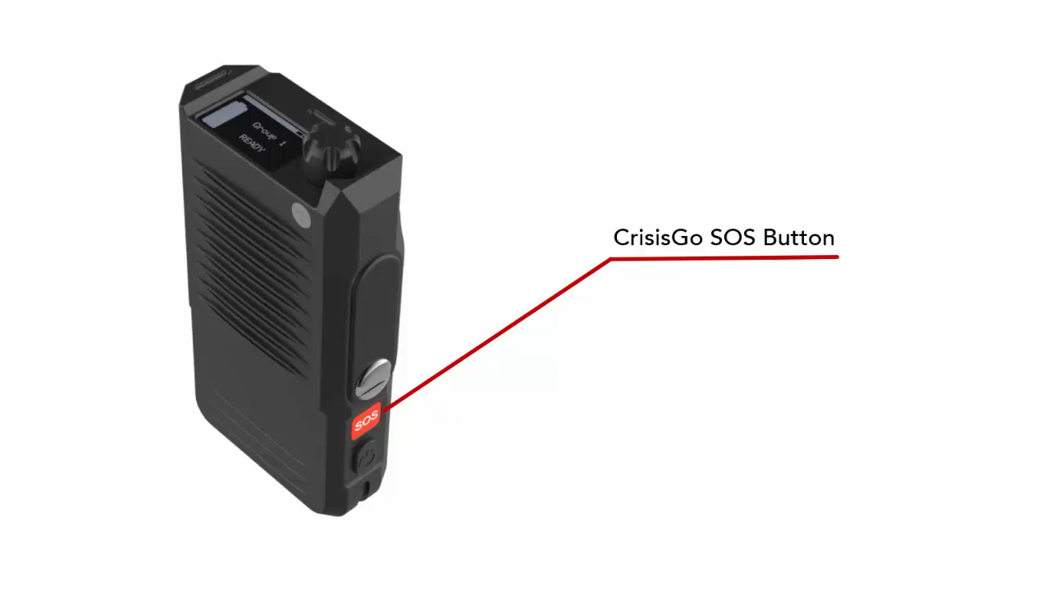
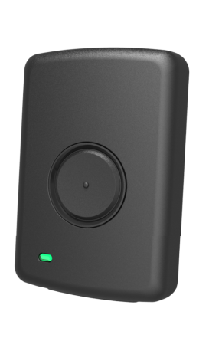

Industry Gap
FULL FEATURED
SAFETY APP
SIMPLE
PANIC BUTTON
THE MISSING PIECE
(watch video above)
crisisgo.com

Slide 19
Demo Time
Single push of a button to trigger a panic alarm and record alert details to send with the panic alarm.
Receive alerts from multiple devices and automatically play alert details through voice transmission.
Immediate connection with 911 and first responders (not in demo).
Instant ongoing communication through push-to-talk.
Receive and answer check-in or poll questions.
Receive text and audio messages (pager replacement).
crisisgo.com

Slide 20


Sales Tools
Learn More
Activate your demo device(s) with CrisisGo
Request demo and assistance from CrisisGo SME
Customer Pilot assistance
Lead lock
YouTube Video: Scan the QR Code or visit https://youtu.be/vyFdN7Wr19s
crisisgo.com

Slide 21
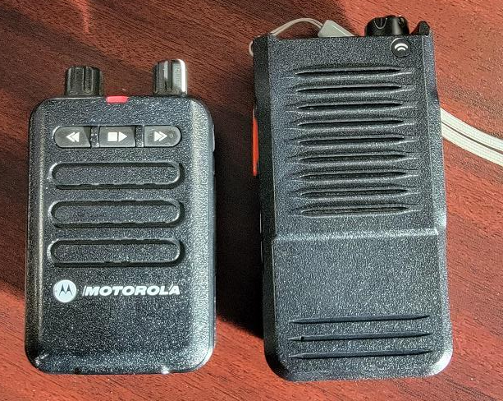
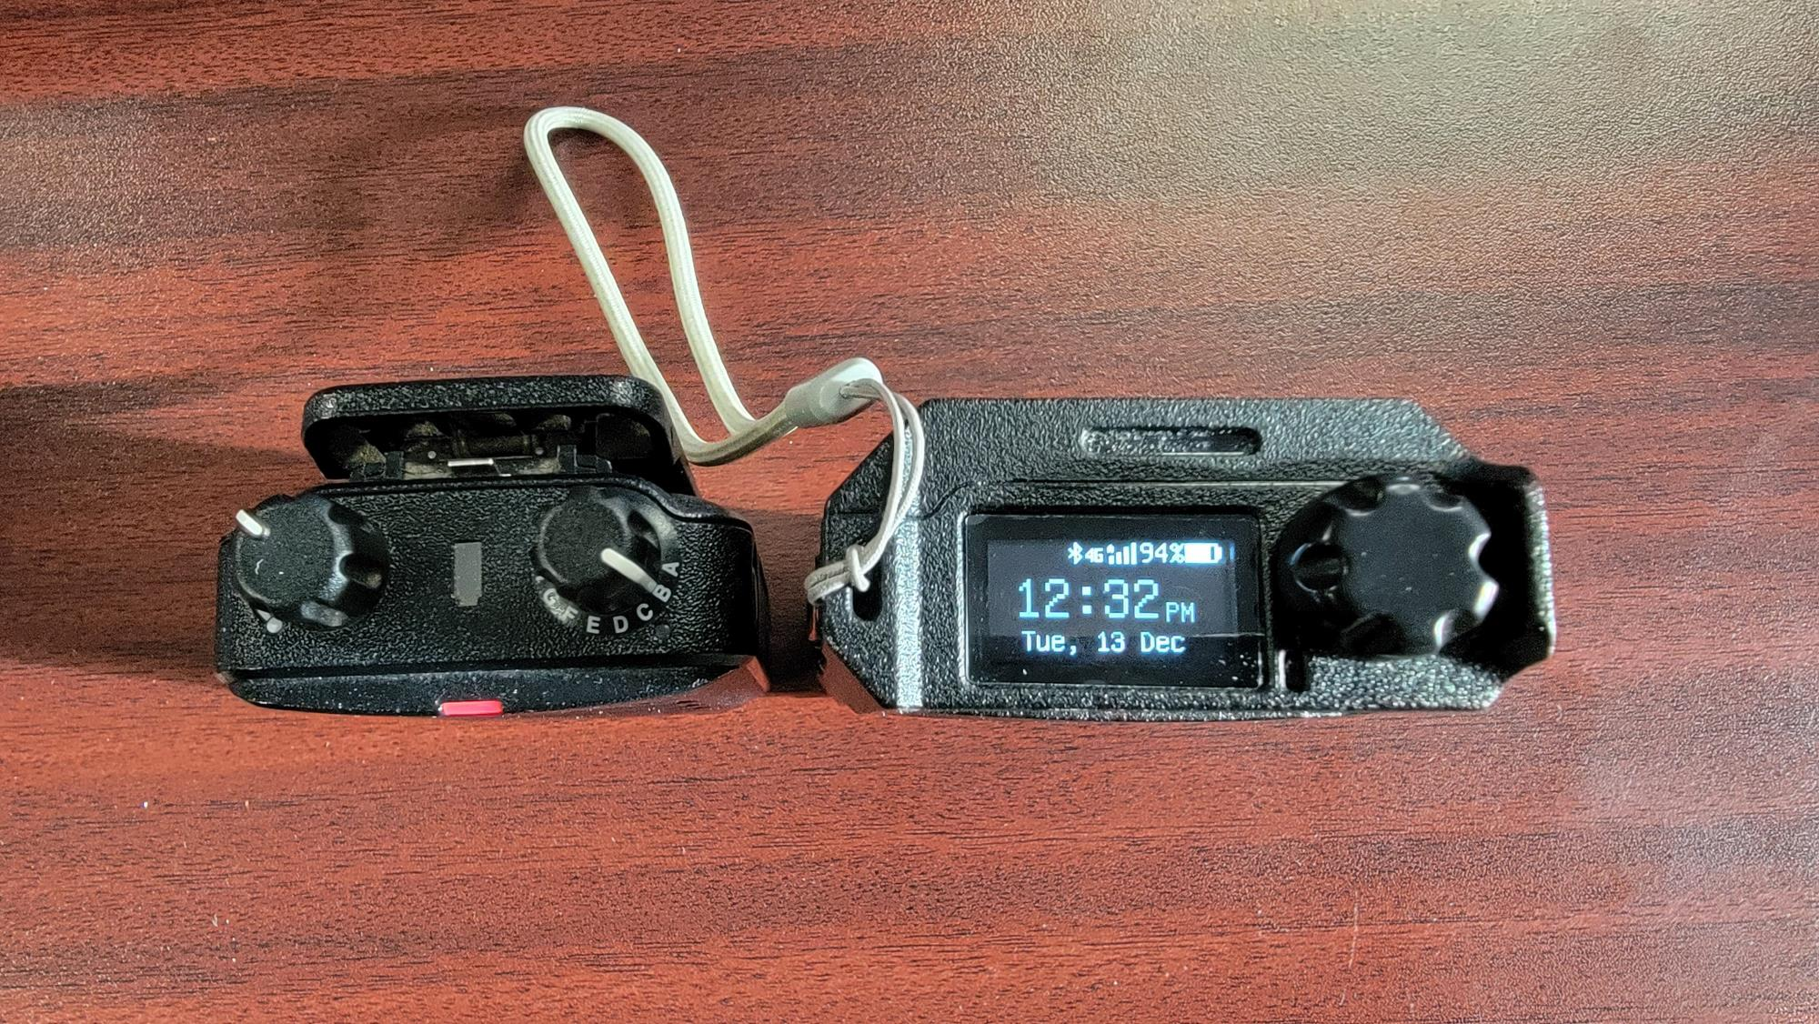
Coming Soon… Pager Replacement Initiative
OCT FOTA Update binds Call Volume & Media Volume together into one adjustment
Proprietary & Confidential

Slide 22
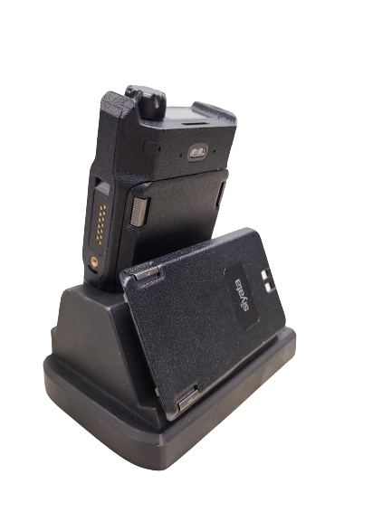
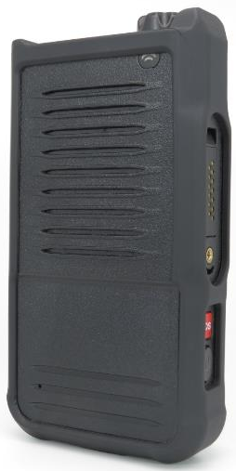
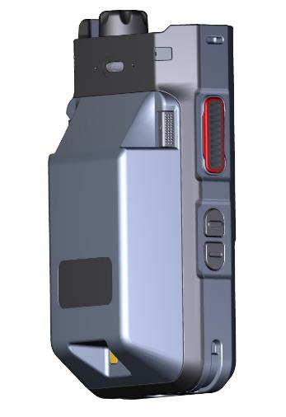
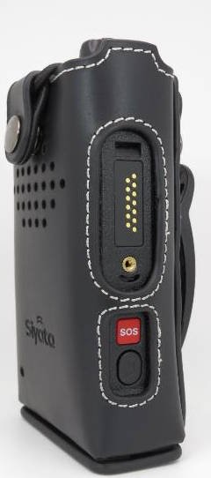
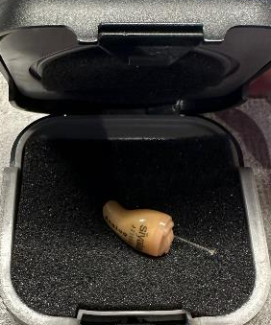
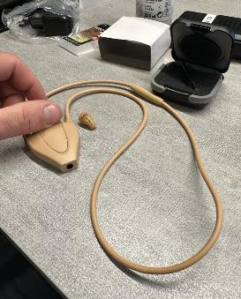
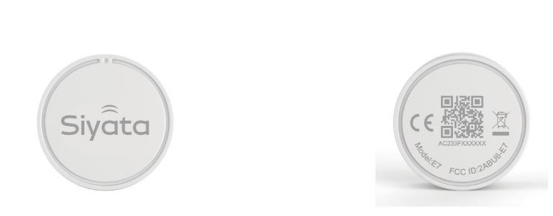
Duty-belt pouch w/metal clip
Coming Soon…
Silicone Case
7800 mAH Battery
Bluetooth Beacon
GPS Lockbox Desktop Charger
Notes:
Jason will review device

Slide 23

Thank You!
For more information, contact us today.
281.667.0404
sales@pwbts.com
premierwireless.com
Notes:
sadf

