Slide 1

School Safety & Communication Continuity

Slide 2

Planning for the unpredictable
Being prepared for the unexpected
Power Outages
Weather Events
Natural Disasters
Medical Emergencies
Active Shooters
Pandemics
School Events
Prevention
Prepare
Recovery
Response

Slide 3

Reduce risk through advanced planning
Strengthening Communication for Safer Schools
Proactive Preparedness: Advanced planning ensures that you are always prepared for unforeseen events, reducing the potential for communication breakdowns during critical times.
Enhanced Safety and Security: By ensuring multiple communication channels, school districts can rapidly respond to emergencies, ensuring the safety of students, staff, and the community.
Efficient Resource Allocation: Advanced planning for communication redundancy avoids last-minute scrambling, ensuring consistent communication flow even in adverse conditions.

Slide 4
REVIEW Your emergency Response plan
Ready for the Unexpected? Assess Your Preparedness.
How does your emergency response plan address communication continuity across every functional department?
What are your contingencies for essential, reliable voice and data communications?
What are your redundancies to reduce or eliminate communication gaps and to ensure your calls and texts go out?
Are you sure your employees’ phones work?
Where is your emergency plan? Can you access it anywhere, anytime?
When did you last analyze, test, and update your communication plan?
Prevention
Prepare
Recovery
Response

Slide 5

Campus & In-building coverage
Where are your coverage challenges?
Hallways
Classrooms
Cafeteria
Gyms
Administration offices
Playground
Sporting fields
Parking lots
What are your Cellular and in-building Limitations?
WI-FI Coverage
Identify where there are gaps
  Full outside coverage
  Construction changes
  Bandwidth limitations from provider
  Obsolete Equipment
  Cellular Dead Zones

Slide 6

Taking action
Cellular Coverage enhancements
T-Mobile Advanced Network Solutions (ANS)
Distributed Antenna Systems (DAS)
Traditional network solutions
Add /Upgrade Access Points
Increase Bandwidth
Add Hardwired Phone Lines
cellular
Supplement With 5G As A Primary Service
Load – Balance To Increase Capacity

Slide 7

Built-in redundancy
What happens when your network goes down?
Phone systems go down
Background checks can’t be completed
Security systems are compromised
Camera Access is lost
What Other internet-connected devices do you have?
When all else fails… What is Plan B?

Slide 8
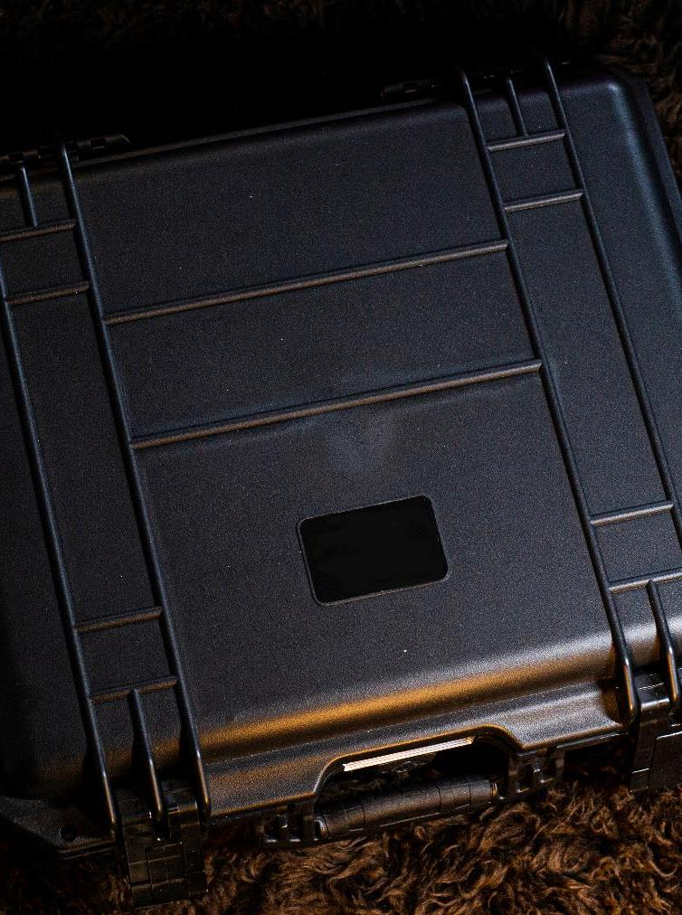
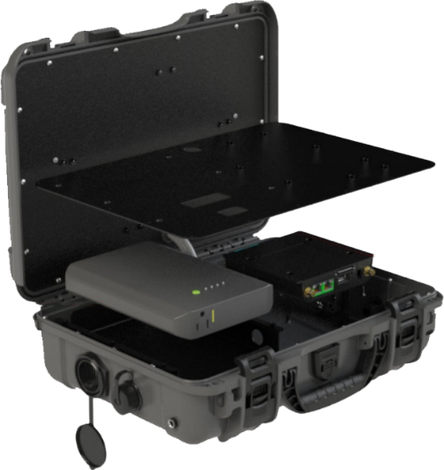
Portable mobile Command Center
Premier’s 5g mobile network-in-a-box
Portable Command Center
50-100 (or more) Endpoints
Communication Continuity
Reunification Plans
Recovery Plans
IP68 Rated for Water & Dust

Slide 9



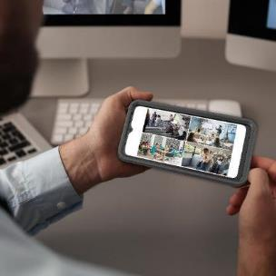

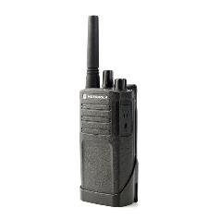
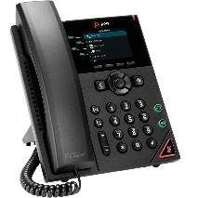
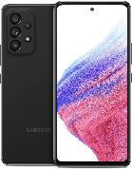
Voice & Data Communication
Desk Phones – Smart Phones – Basic Phones & Radios
UCaaS
Desk Phones & Cell Phones
Laptops & Tablets
Right Devices For The Right Person
District Administrators
School Resource Officers
Principals/Assistant Principals
School Nurse & Counselors
Teachers
Facilities - Technology – Warehouse
Food & Nutrition – Landscaping
Transportation
We can help you create a truly Unified Communication Plan!

Slide 10

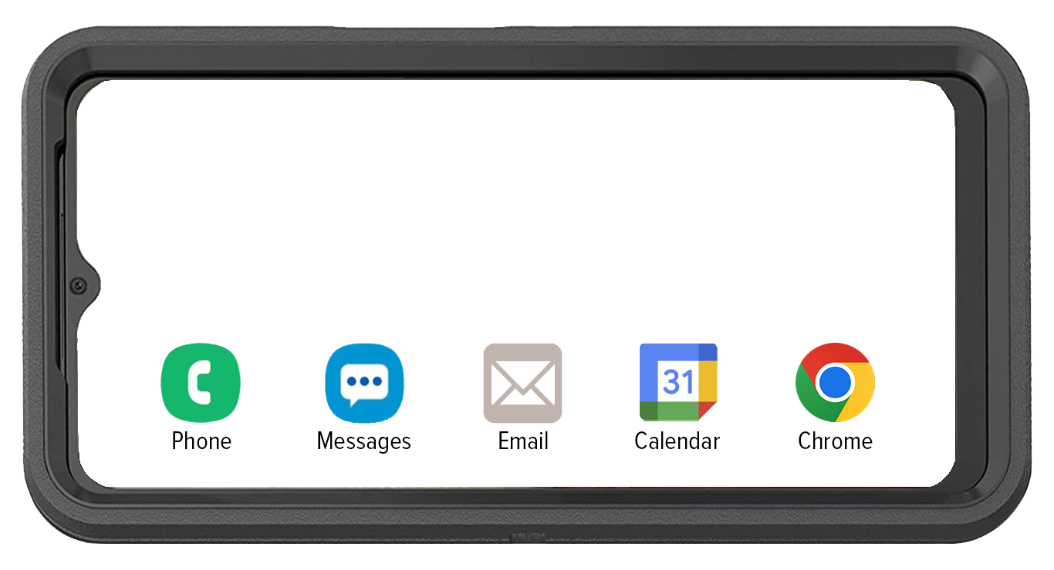
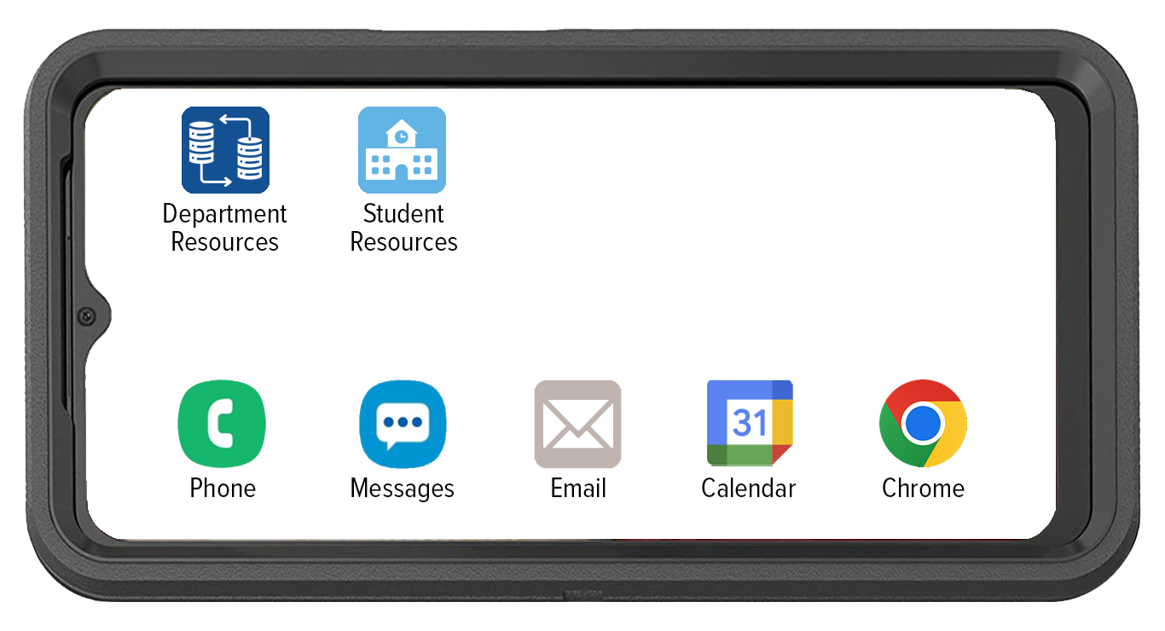

cpr³ – SmartPhones
Connecting People To Resources
Department Resources
Facilities
Landscaping
Food & Nutrition
Technology
Work Orders

Slide 11
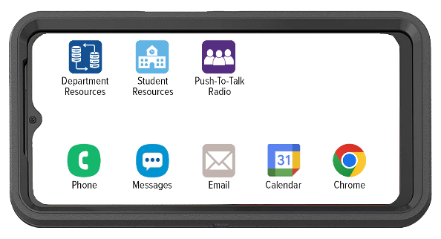




T-mobile Direct Connect PTT
Provides messaging between individuals or groups with support for images, videos, audio, and location sharing
Provides location sharing and tracking capabilities for precise coordination
Supports devices with Push-to-Talk button hardware to help reduce call origination time with One-Touch calling
Gives ability to augment your Land Mobile Radio (LMR) network with
T-Mobile devices
Offers broad device support from rugged PTT devices to conventional smartphones and tablets (iOS and Android)
Allows supervisors to centrally manage contacts, Talk groups, and settings with the Corporate Administration Tool (CAT)

Slide 12
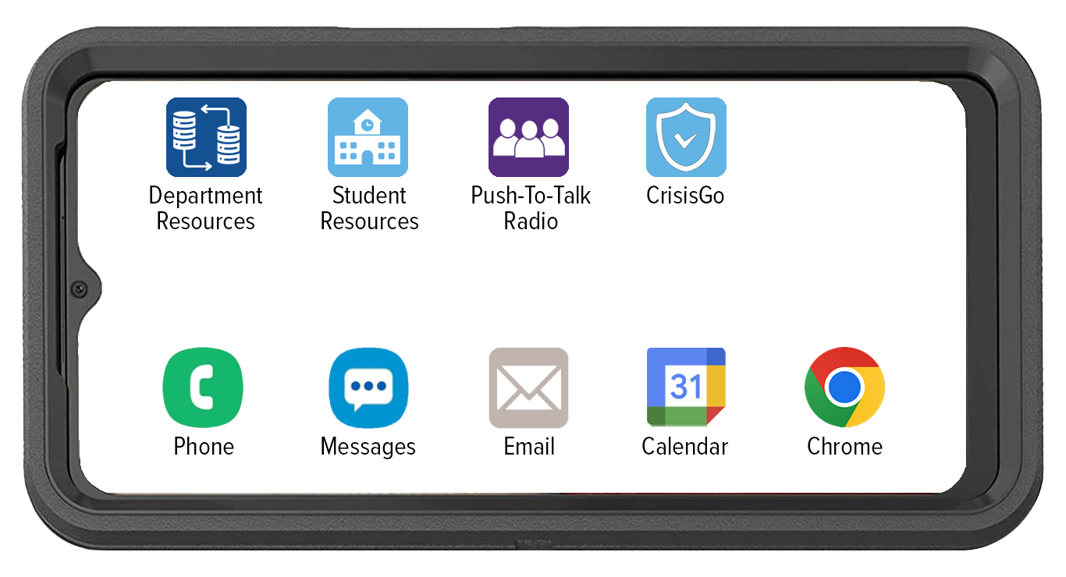
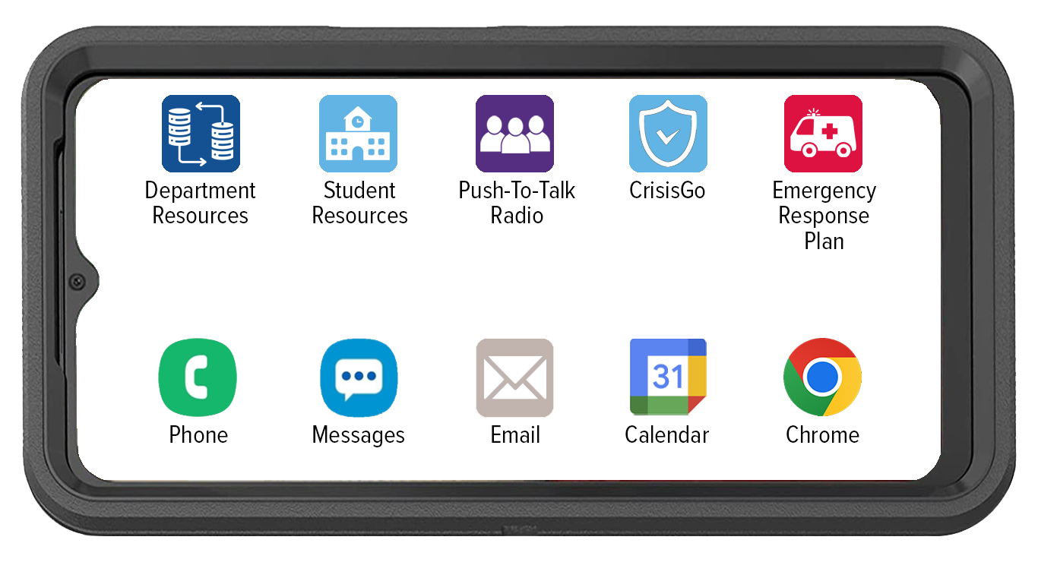
Purpose Driven & Poised for emergency response

Slide 13
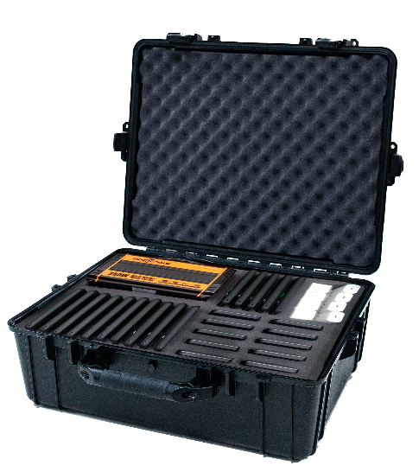
Always ready to go
Premier go-kit
Your Choice of…
Smart Devices
Hotspots
Tablets
Radios

Slide 14
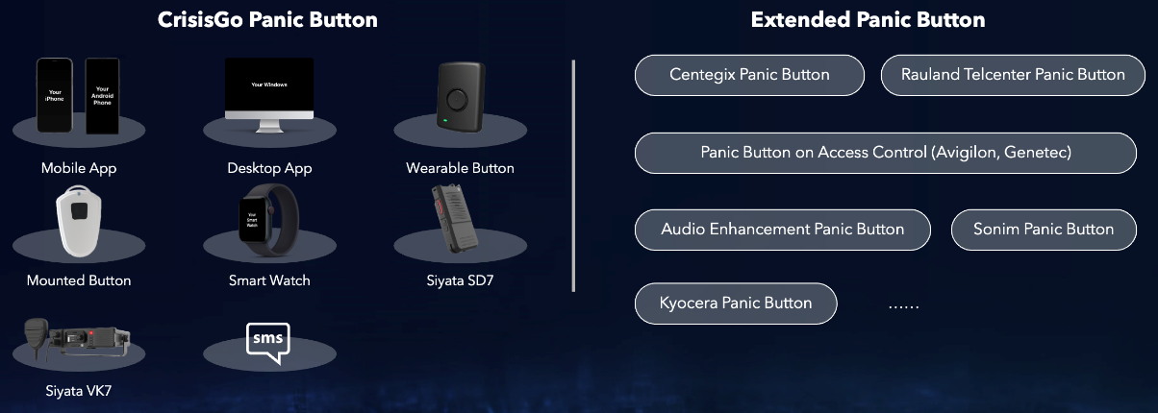
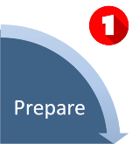
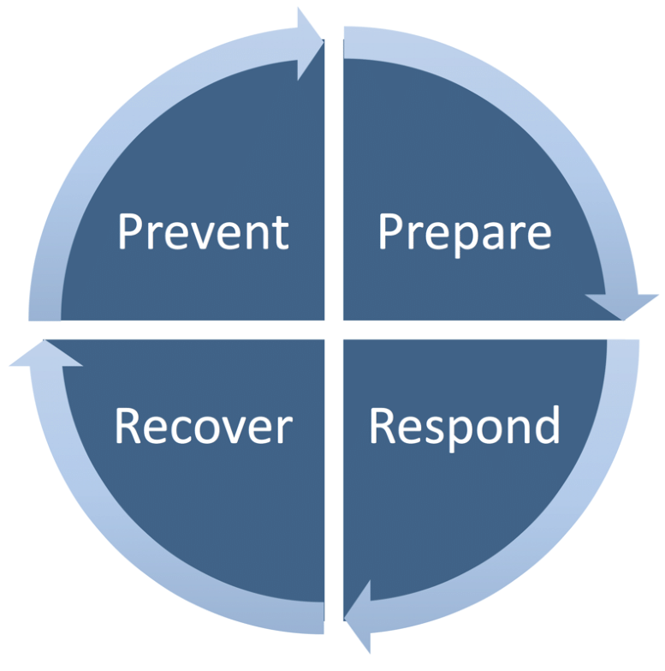


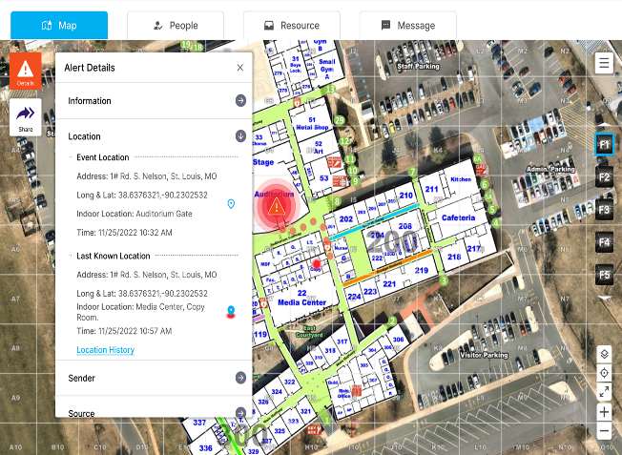

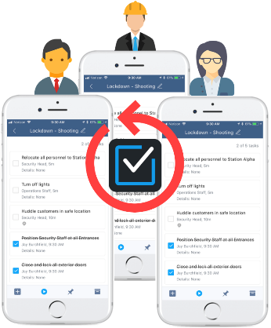
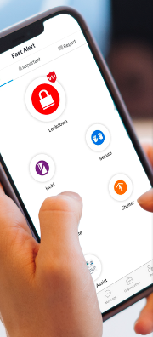
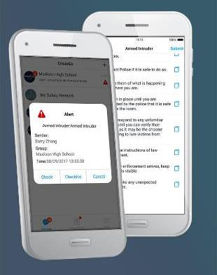

DIGITIZE YOUR EMERGENCY RESPONSE PLANS
ROLE-BASED INCIDENT MANAGEMENT
INTEGRATE YOUR FACILITY MAPS FOR INDOOR LOCATION TRACKING

Slide 15
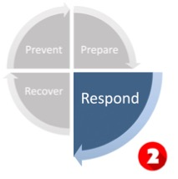



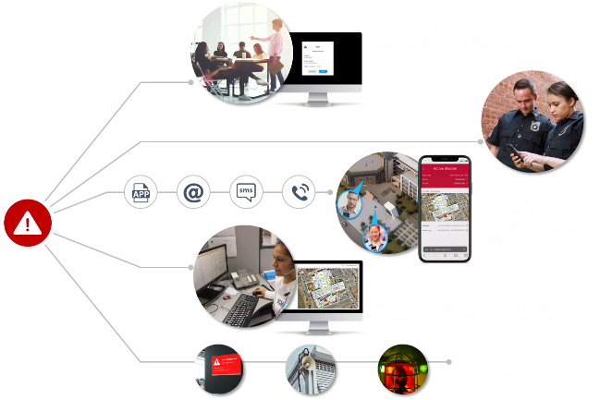
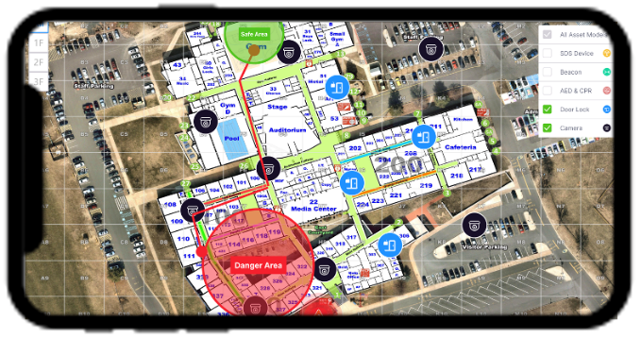

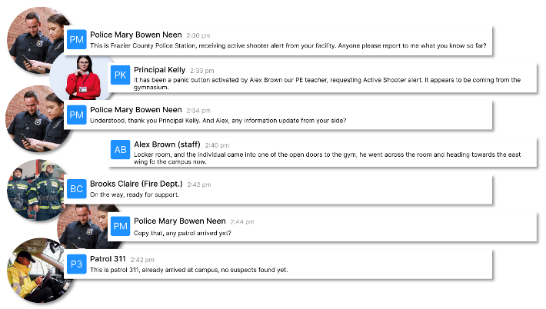
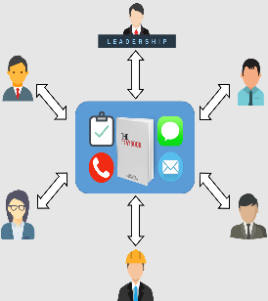

AWARENESS
MASS NOTIFICATION
SYSTEM
PARENTS
GUARDIANS
COMMUNITY
REUNIFICIATION
CRISISGO ACTIVATION
RECOVERY
COORDINATION
TEACHERS
STAFF
POLICE
FIRE
ISD ADMINS
INCIDENT RESOLUTION
INCIDENT RESPONSE
SYSTEM

Slide 16
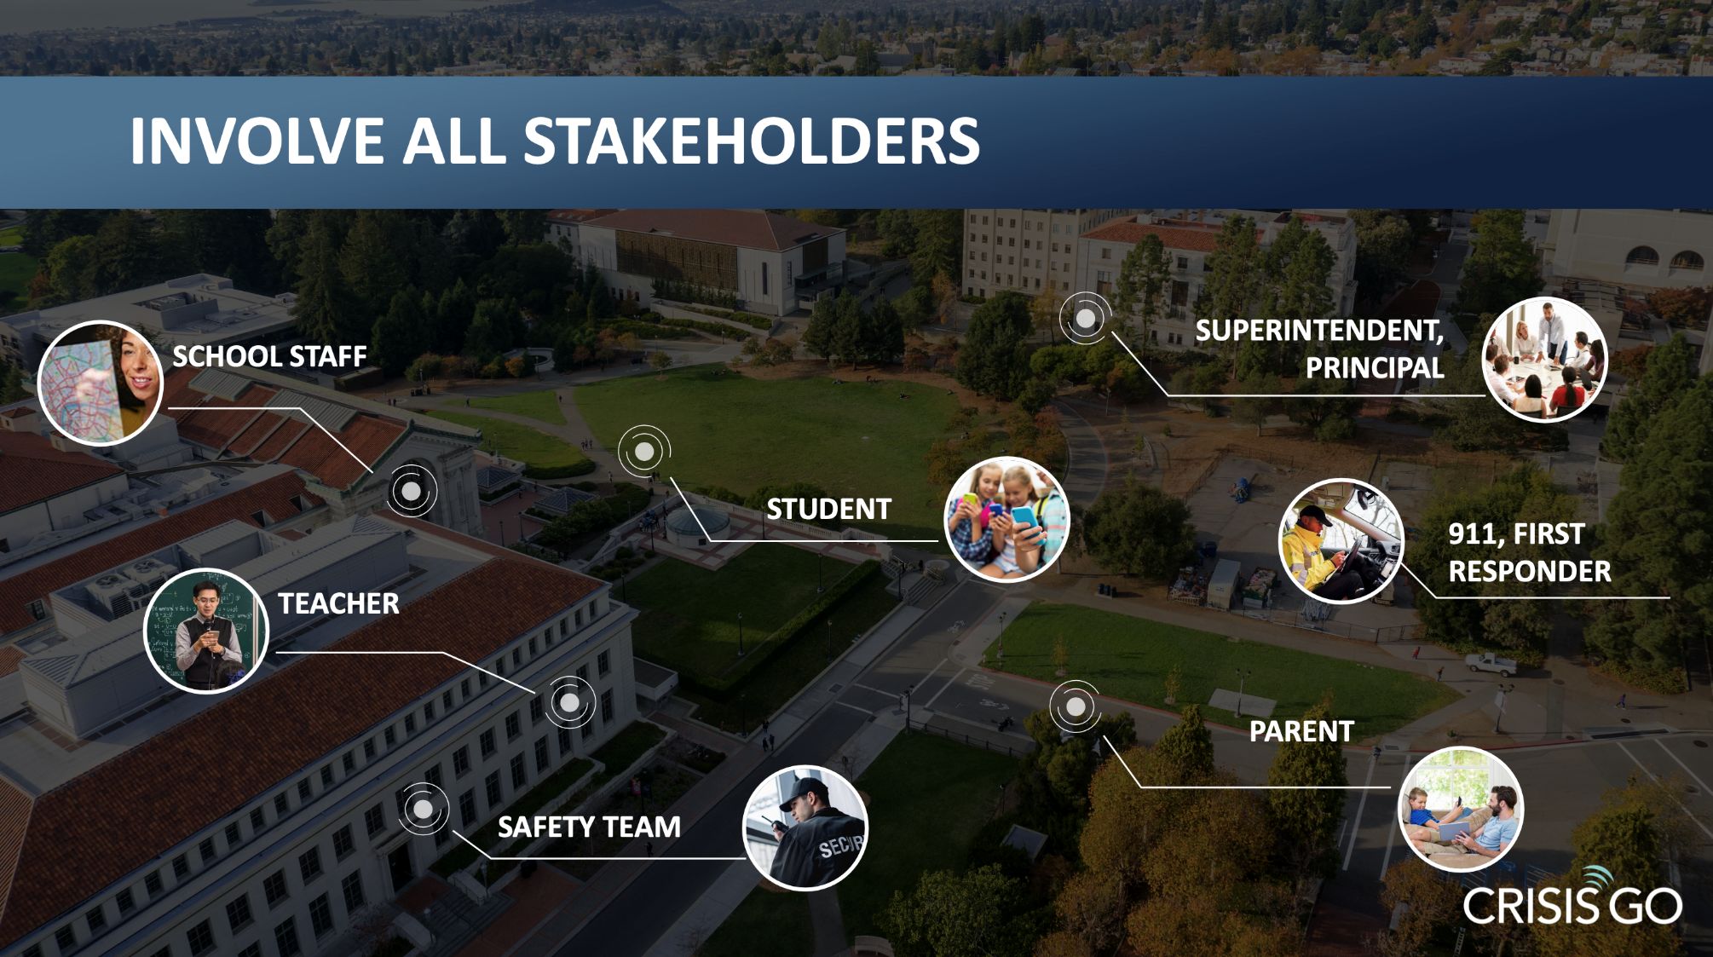

Slide 17

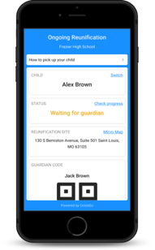
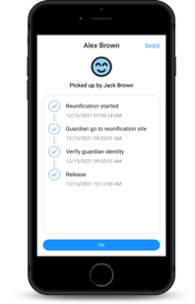
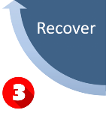
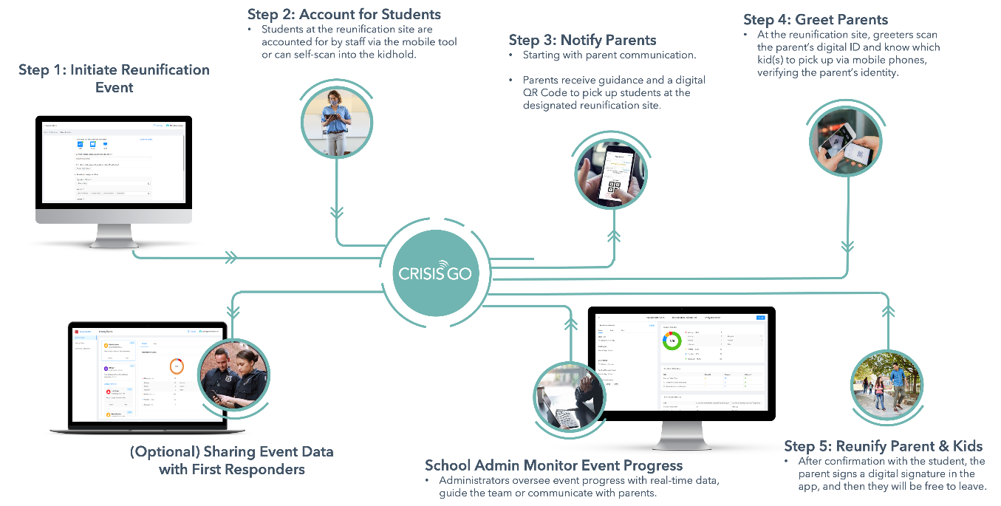


Slide 18
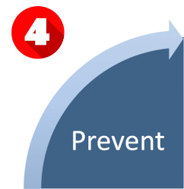

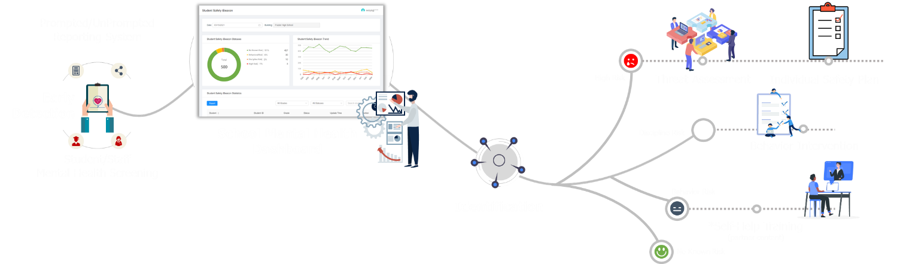
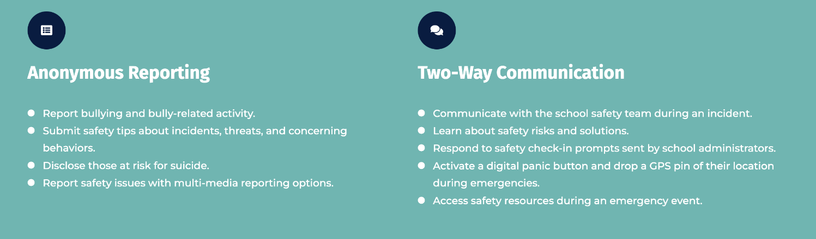
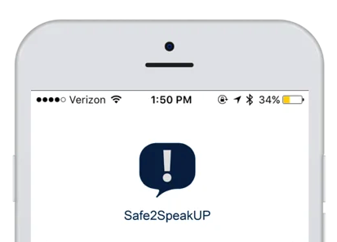


Slide 19

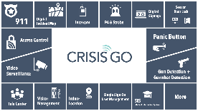
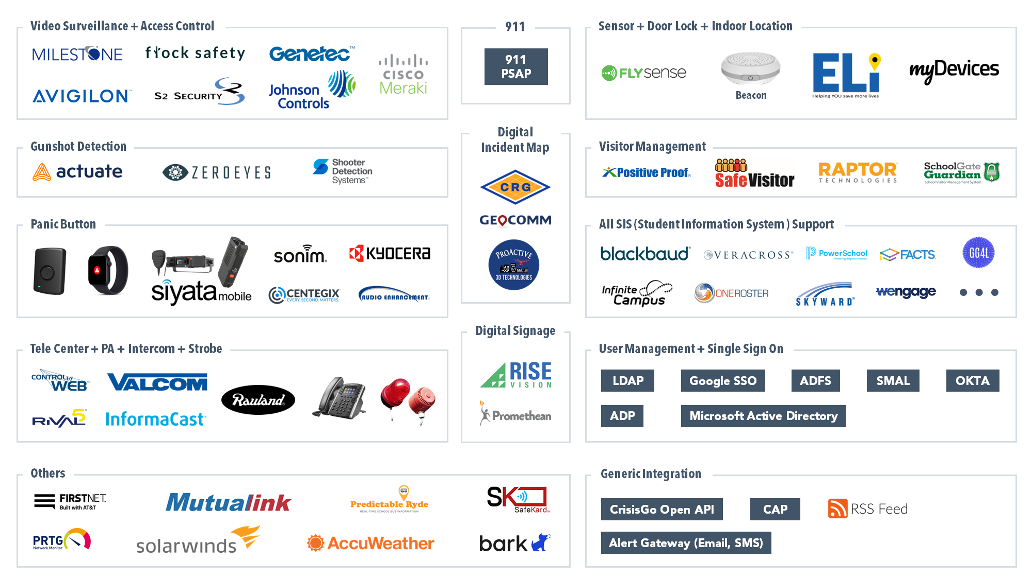

Slide 20
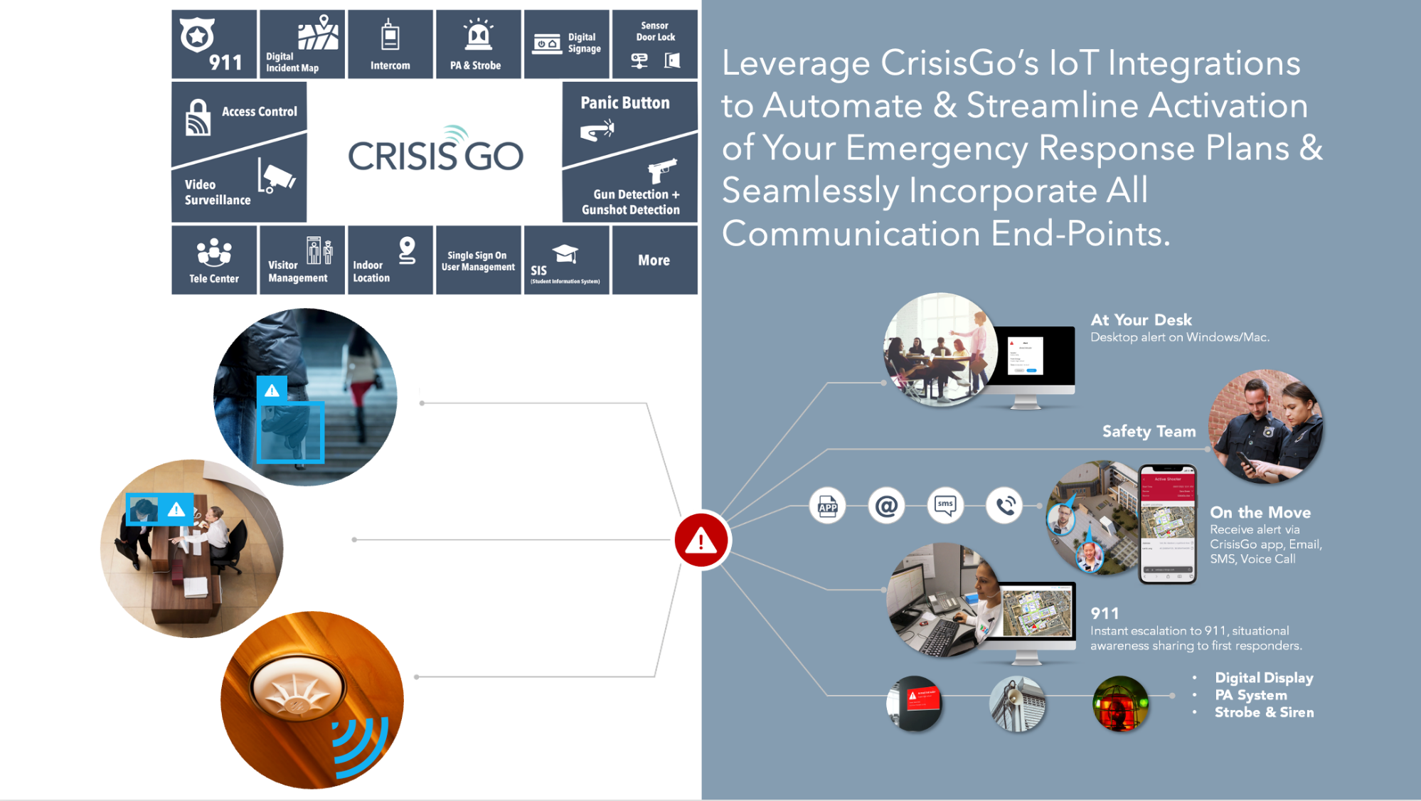

Slide 21
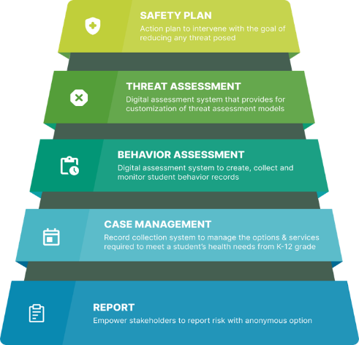
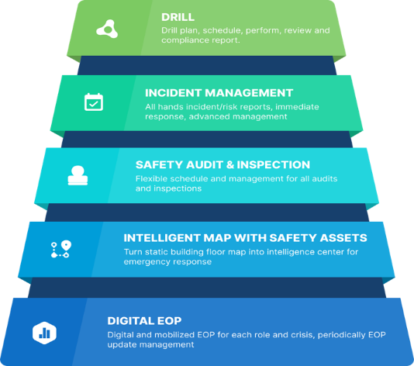

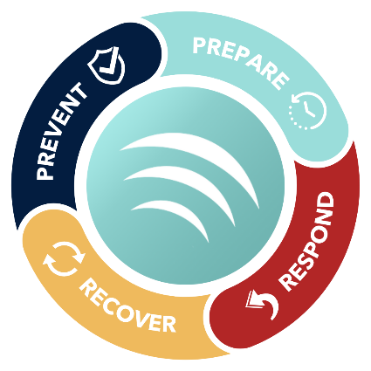
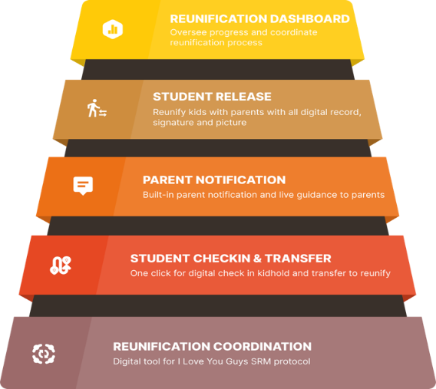
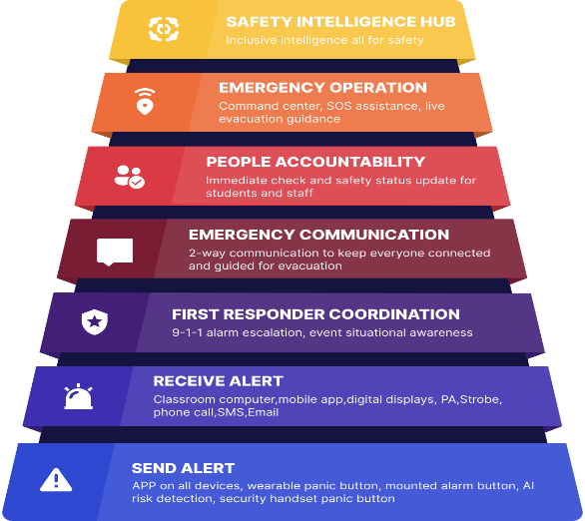

Slide 22
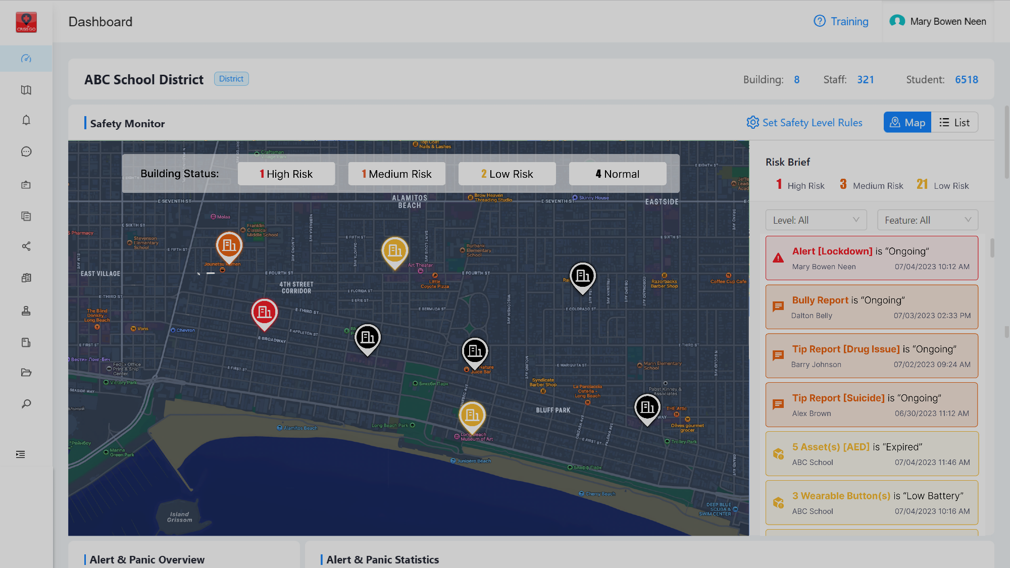
SYSTEM-OF-SYSTEMS APPROACH
COMPLETE OVERSIGHT OF EVERY FACILITY

Slide 23


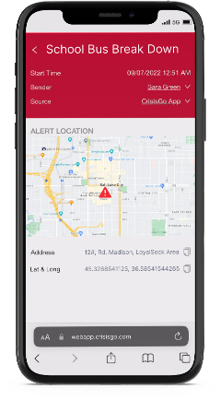

THE SOLUTION: THE VK7
USE-CASE #1 SCHOOL BUS COMMUNICATION & COMPLIANCE
In Most of the States, Vehicles must be equipped with Communication system for emergencies
US Department of Transportation FMCSA rule restricts the use of all hand-held mobile devices by drivers of commercial motor vehicles (CMVs). (Using a hand-held mobile phone while driving a CMV can result in driver disqualification. Penalties can be up to $2,750 for drivers and up to $11,000 for employers who allow or require drivers to use a hand-held communications device while driving.)
Push-To-Talk.
CrisisGo CGSD with:
  Advanced SOS button at your fingertip.
  Paging services.
  Immediately establishing 911 based upon bus location (for major emergency).
  Check-ins.
  Instant communication (group or private).
A simple yet highly functional PTT/CrisisGo only device.
All the benefits of POC without any of the headaches managing the current generation of rugged smart/feature phone.
A Perfect Upgrade from LMR.
Connected to vehicle power.
Integrated 10W speaker w/optional 20W external speaker.
Modularity allowing multiple accessories solution.
Simple “Slide-In” connection.

Slide 24
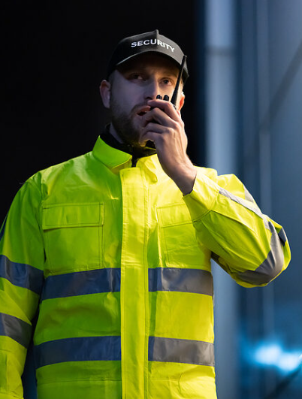
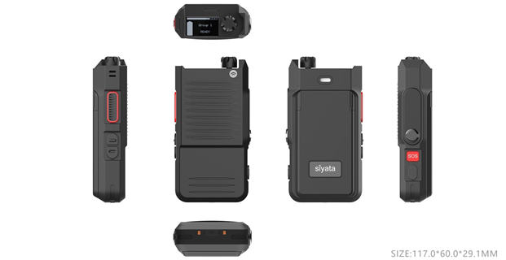
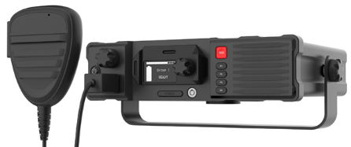
Cellular-based radios & ptt devices
Purpose-driven, rugged devices
One-to-One
One-to-Many
Group Talk
Broadcast
SOS Button
Perfect for:
Front Desk
Custodial Staff
Transportation
Landscaping

Slide 25







Bus ConnectED Bus Connectivity
Real-time
Camera Access
Wi-fi on
The bus
Wi-fi around
the bus
Gps
tracking
Student
Sign on
Cloud
management

Slide 26







Crosswalk Student Ridership
Student tracking & parent app
Gps &
routing
Turn-by-turn
directions
Field trip
management
Pre & post
Trip inspections
School information system integration

Slide 27



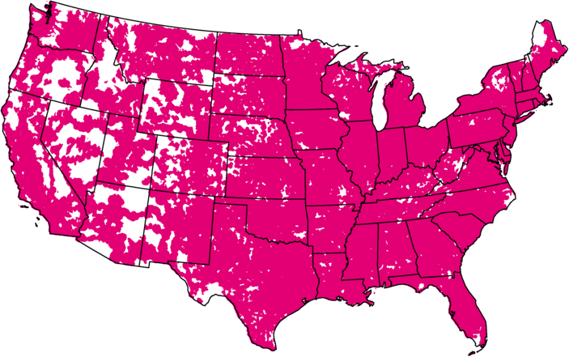
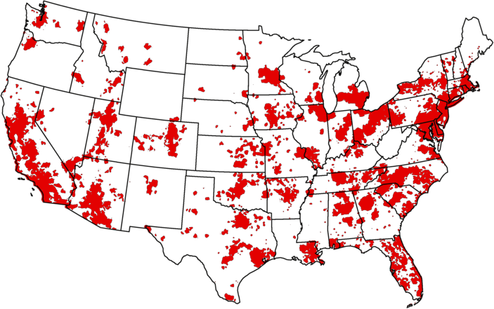
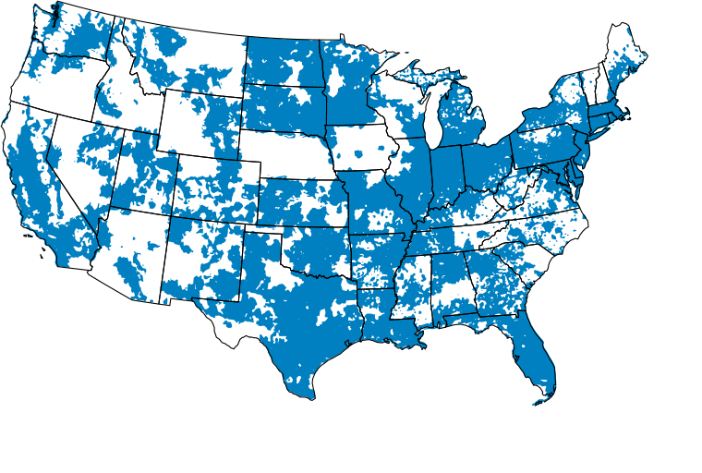
We have a clear and demonstrable lead in 5G.
Low-band | Extended Range 5G: 2.0M sq. miles 330M people covered | 5G Nationwide 0.5M sq. miles 249M people covered | 5G Nationwide 1.4M sq. miles 300M people covered
Mid-band & mmWave | Ultra Capacity 5G: 300M people covered | Ultra Wideband: 222M people covered | 5G Plus: 190M people covered
01.2024
Notes:
[UPDATED JUNE 2023]
These maps clearly show the coverage advantage we have with our low-band Extended Range 5G vs. our competitors low-band 5G “nationwide” footprint.
Our low-band Extended Range 5G covers 326 million Americans and 2.0 million square miles.
Our nation-wide Ultra Capacity 5G covers 275 million POPs today.
With their introduction of C-band spectrum, Verizon’s Ultra Wideband now covers 200 million by comparison and AT&T’s 5G Plus covers 160 million.
SOURCE: Competitive earnings reports 1Q2023

Slide 28

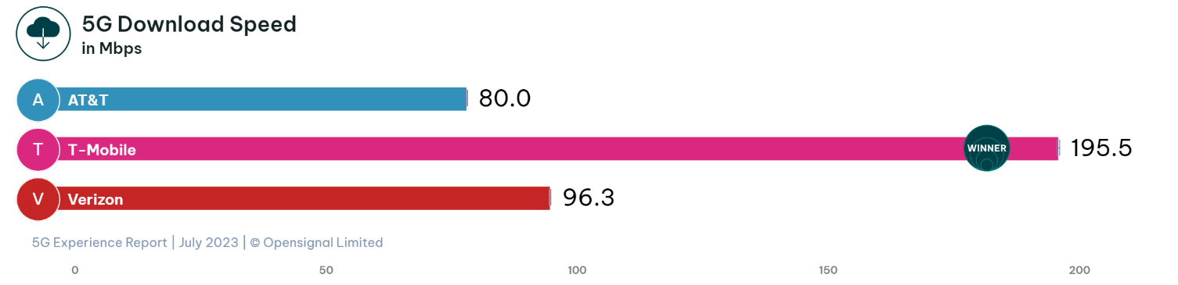

T-Mobile is America’s leader in 5G.
See what independent experts are saying.
Opensignal: Opensignal US Mobile Network Experience 5G, July 2023 Based on independent analysis of average speeds from mobile measurements recorded during the period March 16 – June 13, 2023, © 2023 Opensignal Limited 5G: Capable device required for 5G; coverage not available in some areas. Some uses may require certain plan or feature; see T-Mobile.com.
Notes:
[UPDATED JULY 2023]
The latest independent data from Opensignal, based on real world customer usage from millions of device measurements, recognized T-Mobile as the leader in the following categories.
5G Download Speed: The average download speed observed by Opensignal users with active 5G connections.
5G Availability: The percentage of time users had active 5G connections.
( https://www.opensignal.com/reports/2023/07/usa/mobile-network-experience-5g )
USA, July 2023, 5G Experience Report | Opensignal

Slide 29



T-Mobile is America’s network leader.
See what independent experts are saying.
T‑Mobile’s network once again earned top rankings for fastest speeds, most consistent, best video, lowest latency, best 5G speed performance and 5G availability. | T-Mobile dominates the awards table again, with six outright wins out of a possible eight. T-Mobile strengthens its lead for both speed awards and is the first U.S. carrier to win the new Consistent Quality and Live Video Experience awards. | In its latest 5G Network Performance Audit Report, T-Mobile once again had the overall highest 5G score with the best coverage, stability and speeds.
Ookla: fastest based on median, overall combined speeds according to analysis by Ookla® of Speedtest Intelligence® data download speeds for Q1 2023. Ookla trademarks used under license and reprinted with permission. Opensignal: Opensignal US Mobile Network Experience 5G, July 2023 Based on independent analysis of average speeds from mobile measurements recorded during the period March 16 – June 13, 2023, © 2023 Opensignal Limited. umlaut: according to an audit report conducted by independent third-party umlaut containing crowdsourced data for user experience including task completion collected from October 24, 2022, to April 9, 2023. Full details at: www.umlaut.com/en/benchmarking/USA.
5G device required for highest speeds
Notes:
[UPDATED JULY 2023]
Our market research shows that claims supported by third-party sources carry more weight than those that we simply make ourselves.
Here is what three of the industry’s independent benchmark firms have to say about the T-Mobile network.
Independent 1Q 2023 data from Ookla, based on real world customer usage from millions of device measurements.
Ookla: www.speedtest.net/global-index/united-states#market-analysis
Independent 2Q 2023 data from Opensignal,
Independent data from umlaut (now part of Accenture), based on real world customer usage from millions of device measurements.
umlaut: 2022/07 5G Network Performance US - Audit Report

Slide 30

Wireless priority Service (WPS)
In an emergency, the wireless network may become severely congested and reach 100% of capacity. Priority Access and preemption help ensure users with WPS still get through.
End-to-end prioritization
Using WPS by dialing *272 or the
PTS Dialer app ensures end-to-end prioritization, regardless of which
carrier is at the other end.
Priority access
T-Mobile subscribers with WPS get moved to the front of the communication line.
Preemption
If necessary, a customer without WPS will be dropped to make room for one with WPS.
WPS functionality (including priority access and preemption) may not be available while roaming. Completion of calls not guaranteed.

Slide 31

Communication Continuity planning
We’re here to help
Have a plan
  How do we address coverage challenges?
  What if we lose internet connectivity?
  How do we communicate internally?
  How do we communicate with emergency responders?
Test it regularly
  Where do we have gaps in coverage?
  Who else needs to be included?
Revise as needed
  How do we make it better?
  How do we make it memorable?
Next Steps? How can we help?

Slide 32


How can we help you?
Reach Out To us today!
bit.ly/K12CommunicationPlanningWeb
(281) 667-0404
www.premierwireless.com

